Slide 1

FROM M&E to EL&A: Improving what we measure and why
Lessons from FH’s Experience in Building Organizational EL&A Culture

Slide 2
Presentation Outline
Where we came from?
Where we are today?
Where are we heading towards?

Slide 3
The Journey Begins:
Where we came from?
From one staff to more than 30 today

Slide 4
Initiation of M&E in FH
Introduction of new FH’s Program Model called Child Focused Community Transformation (CFCT) in 2013
  CFCT is Food for the Hungry’s (FH) model for transformational development. At the heart of the CFCT model is the welfare of the most vulnerable population in most societies – children.
  The CFCT model grew out of FH’s Child Development Program and its love and care for children, FH’s expertise in multi-sectorial food security programs, and a desire to see children thrive in key relationships within healthy families and communities.
  This will permit them to reach their God- given potential while they grow.

Slide 5
M&E Linked to FH’s Heartbeat
Value # 3 : We invest wisely and focus on results
  We are stewards in God’s Kingdom and strive to invest all resources to maximize Missional Impact
Organizational Purpose
  Together we follow God’s call responding to human suffering and graduating communities from extereme poverty
Organizational Strategy
  Facilitate graduation of 150 communities by 2020
  Graduate X people out of poverty
  Accurately monitor impact
  Learn from CFCT

Slide 6
M&E- A Different Perspective
What M&E is not…
  It is not only about data collection
  It is not only about writing reports
  It is not an administrative task or over head expenses
From M&E to L&E
  Not the numbers that show up in the report but what the numbers tell us and what we do with the numbers.
  Important recognition that the changes that come about from M&E, What we learn and how we adapt in response to that learning.
  De-emphasize monitoring and evaluation as operational functions, replacing them with learning and adaptation: moving from M&E to L&A.

Slide 7
Strategic Business Objective of L&E Team
  Promote Learning and Accountability
  Establish a Monitoring & Evaluation Culture in FH
  Evidence Based Decision Making
Objectively contributing to the organizational culture of result oriented learning and evidence based decision making.
Notes:
The three objectives go together and they are not mutually exclusive. We have to have all three in place prior in order to make organization data driven

Slide 8
FH's M&E Journey
Growing as a data-informed organization
2013-14
- Staff
- Tools
- Global Indicators
-Baselines
2015
- M&E Standards
- Graduation Framework
- Country Strategies
2016
- Technical Trainings
- Implementation
- Monitoring
2017
- Evaluation Pilot
- M&E database
- Learning
2018 & Beyond
- Country Program Evaluations
Data-informed graduation decisions
Learning and Adaptation

Slide 9
L&E Enablers
DATA COLLECTION DATA COMMUNICATION KNOWLEDGE AND ACTION
Collect relevant data about Ministry | Visualize and provide insights | Technology that drives beneficial action and content
The right skills around analytics and visualization | Interpretation of data into actionable insight and knowledge | Personalization and Channel expertise
Robust documentation and quality assurance | From trading reports to analysis and fall outs | Continuous results oriented experimentation
PROCESS PEOPLE TEC HNOLOGY

Slide 10
Where we are today?
Member of SLTs
Regular data insight and presentation to SLT meeting
Pause, Intentional Reflection and Learning Events

Slide 11
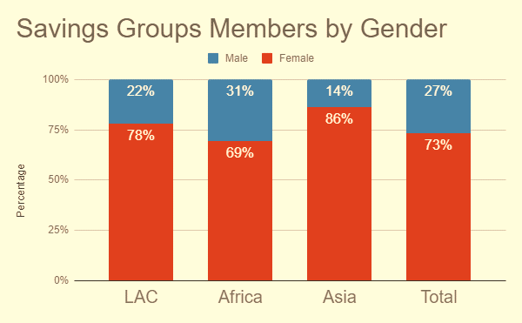
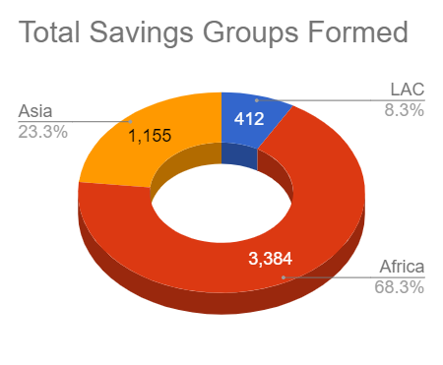
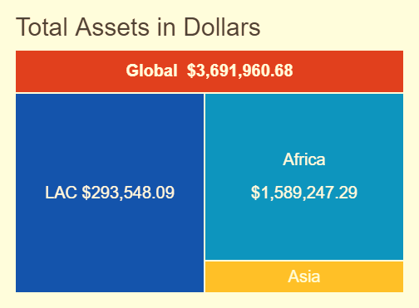
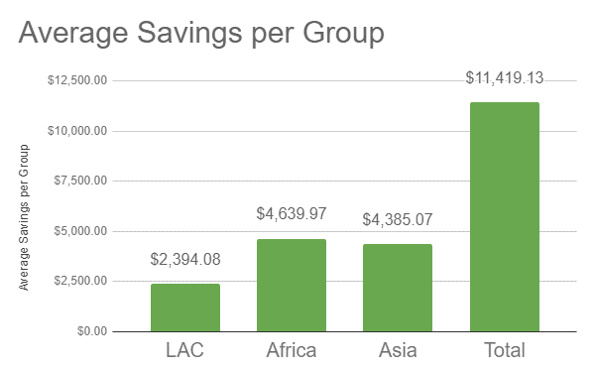
SAVINGS GROUPS
Total
4,951

Slide 12
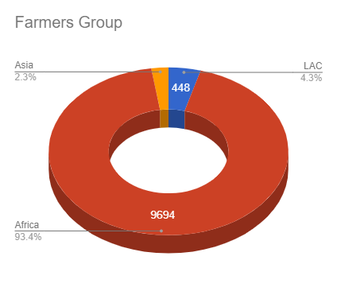
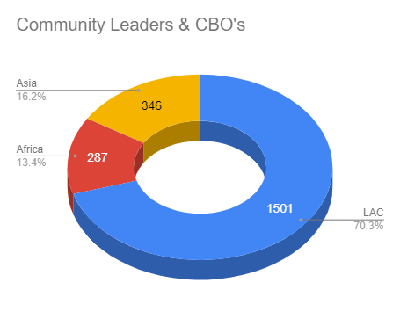
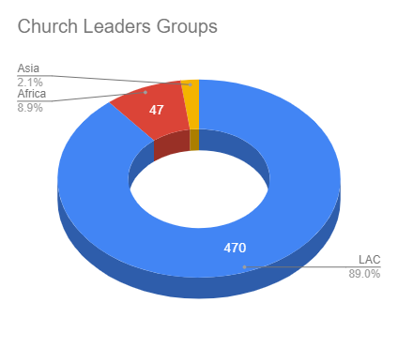

COMMUNITY
GROUPS
Total
10,381
13,042
Total
2,134
Number of Community Groups Formed
Total
528

Slide 13
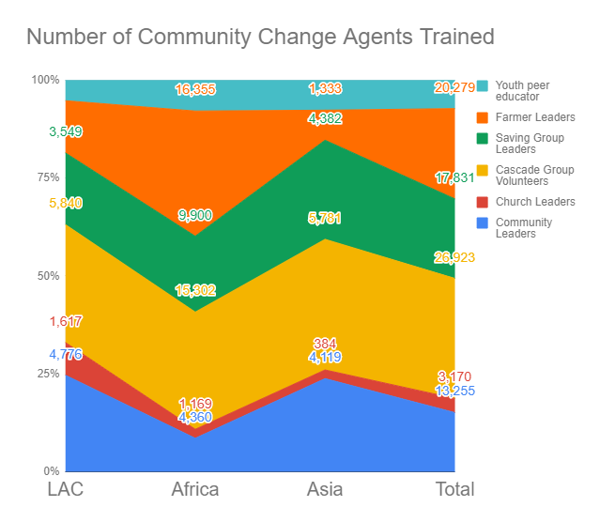
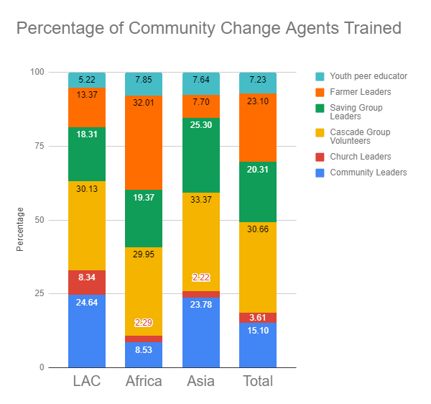
CHANGE AGENTS TRAINED
Total
87,804

Slide 14

Child Focus Community Transformation - Program Theory
Gender equity and
dignity
respected
Increased resilience
and reduced
disaster risk
Graduating Communities from Extreme Poverty
Improved food
security and
livelihoods
Reduced childhood
stunting
Culture
aligned to
God’s goodness,
beauty and truth
Sustainable
change driven
by community
and church leaders
Achieved
childhood
literacy and
numeracy standards

Slide 15
FH’s Monitoring and Evaluation Framework
Transformational Development Framework
CFCT Program Theory
Visible Indicators
Invisible Indicators
Measurement Methodology
Community Graduation
Progress out of Poverty
Learning and Reflection
Quantitative
Qualitative
Data Usage
Evidence Based Decision Making
Improve CFCT and TD Frame

Slide 16
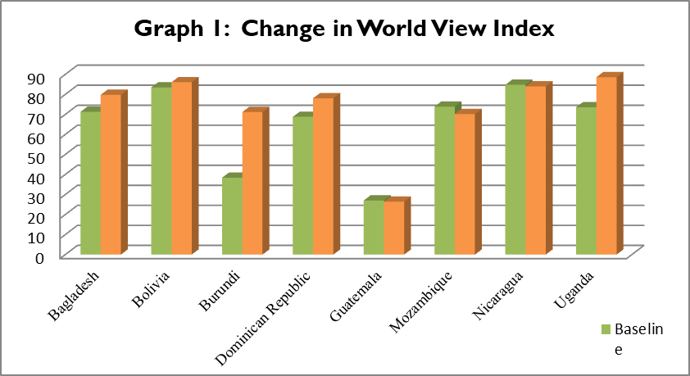
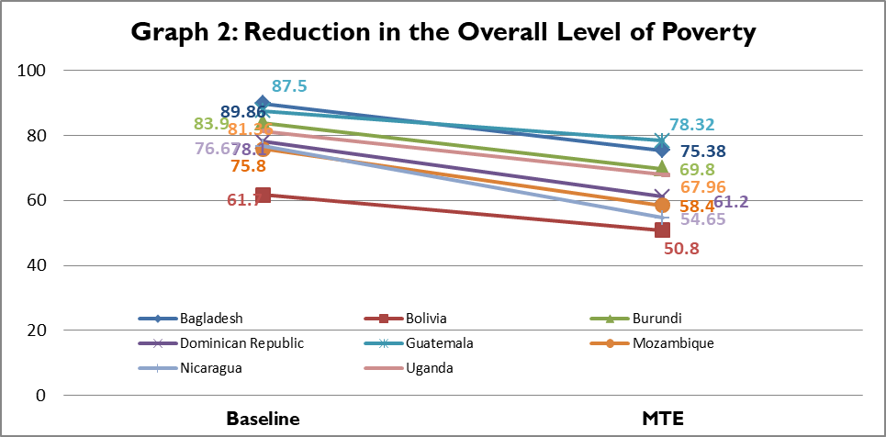
Evaluation Results
Theological and Theoretical Basis
Measurement Framework
                Dimensions of Poverty
        Invisible and Visible
Community Graduation Readiness Index

Slide 17
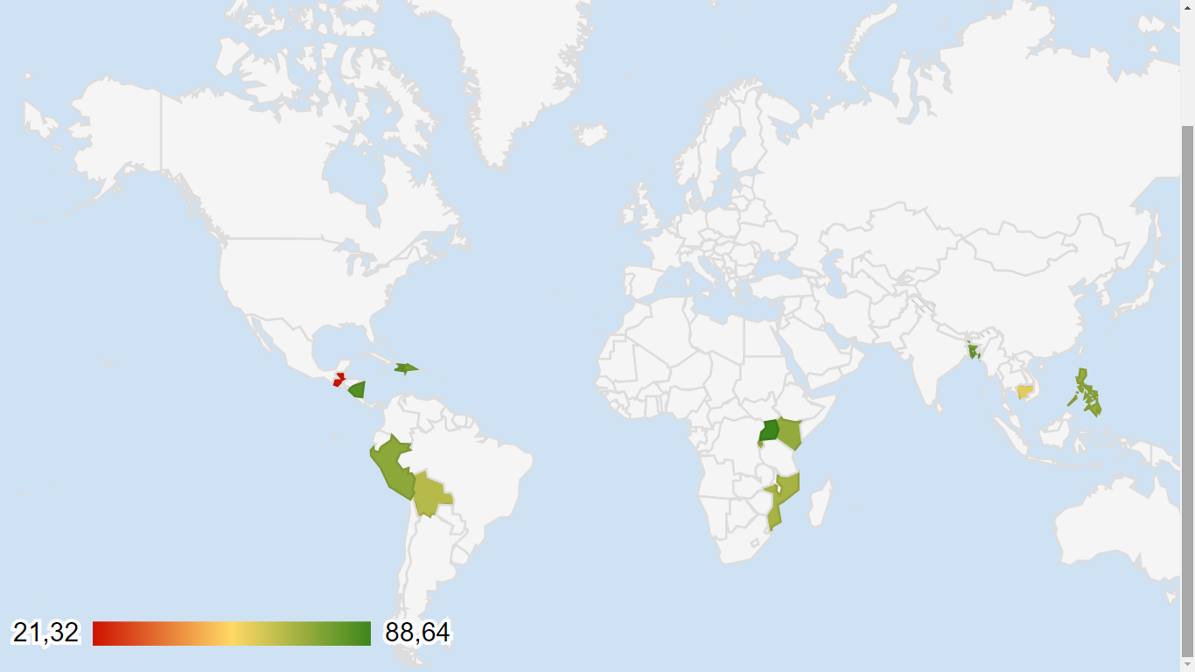





13
Countries Measured both Baseline and Mid Term
Baseline
Mid Term
WORLDVIEW
4
Countries Above Global Average
73.03
Global Average
Average worldview index score
-9.9%
Median Change
Haiti
81.3
Bangladesh
79.8
Guatemala
21.3
Nicaragua
84.0
Dominican Republic
78.1
Uganda
88.6
Kenya
73.6
Cambodia
60.1
Philippines
73.0
Rwanda
72.7
Burundi
70.8
Peru
74.9
Bolivia
67.5
Mozambique
70.2
RANGE (%)

Slide 18
IMPACT

Slide 19
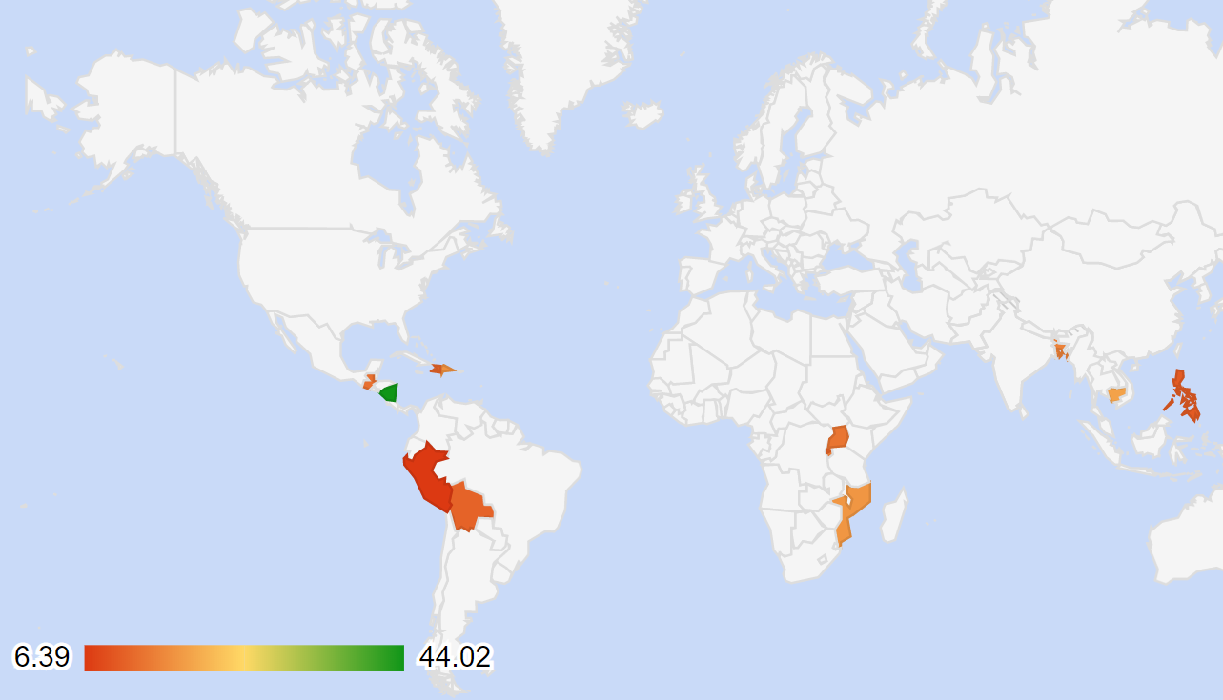

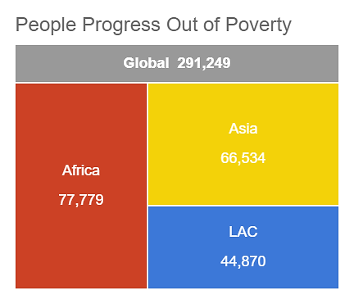
291,249
People Progress Out of Multidimensional Poverty
MULTI-DIMENSIONAL POVERTY
67.9
Global Average
11.71%
Median Change
Haiti
11.5
Bangladesh
14.8
Guatemala
12.9
Nicaragua
44.2
Dominican Republic
16.7
Uganda
13.4
Cambodia
18.7
Philippines
10.41%
Rwanda
11.5
Burundi
14.1
Peru
6.3
Bolivia
11.3
Mozambique
70.2
RANGE (%)

Slide 20
Community Graduation Readiness – Use of Results from CFCT Mid Term Evaluations

Slide 21

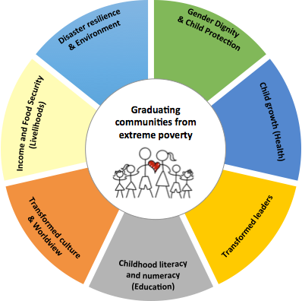




Learning and Adaptation in M&E
INDICATORS THAT NEED WORK
DRR Management Index, Personal Resiliency Score and DRR World View Index were dropped and replaced by Disaster Specific Resilience Score
Gender Empowerment Index
Infant/child Dietary Diversity score is replaced by Minimum Acceptable Diet. However we retained Stunting as the global GKPI.
Intimate Partner’s Violence
Leadership Effectiveness Index
Household Diversity score has been replaced by two new indicators: Months of adequate household food provisioning and Household Hunger Scale
Disaster Specific Resilience Score
Average change in Community and Church Leaders checklist have been dropped and replaced by Leadership Effectiveness Index (tools yet to be developed).
Some countries measure Deworming, however it is no longer a GKPI
Worldview Score to align with God’s story

Slide 22
Where are we heading towards?
Organizational Moments of Learning and Reflection
Data to Decision Initiative,
Learning Lab (Data journey from source to decision making and adaptation)

Slide 23
Learning and Adaptation
Country Program Level
  Revising Country Strategies
  Vision of Success
Organizational Level
  New Program Model
  Adjusting Measurement Model

Slide 24
Vision of Success as Country Strategy Development Tool
Vision of success
Key success
factor
Key success factor
Key success factor
Key success factor
Key success factor

Slide 25
Learning and Adaptation - Week at a Glance
VISION OF SUCCESS
Day 1: What opportunities are laid in front of us that allow us to leverage learning from the past and shape our future? (Data and Reflection)
Day 2: What programmatic model (approach, strategies and technical components) do we need to take to respond to the identified opportunities? Adaptation
Day 3: What type of infrastructural support (human resources, finance and business systems and processes) do we need to achieve our desired future (strategic goal)? Data, Reflection, Learning and Adaptation

Slide 26
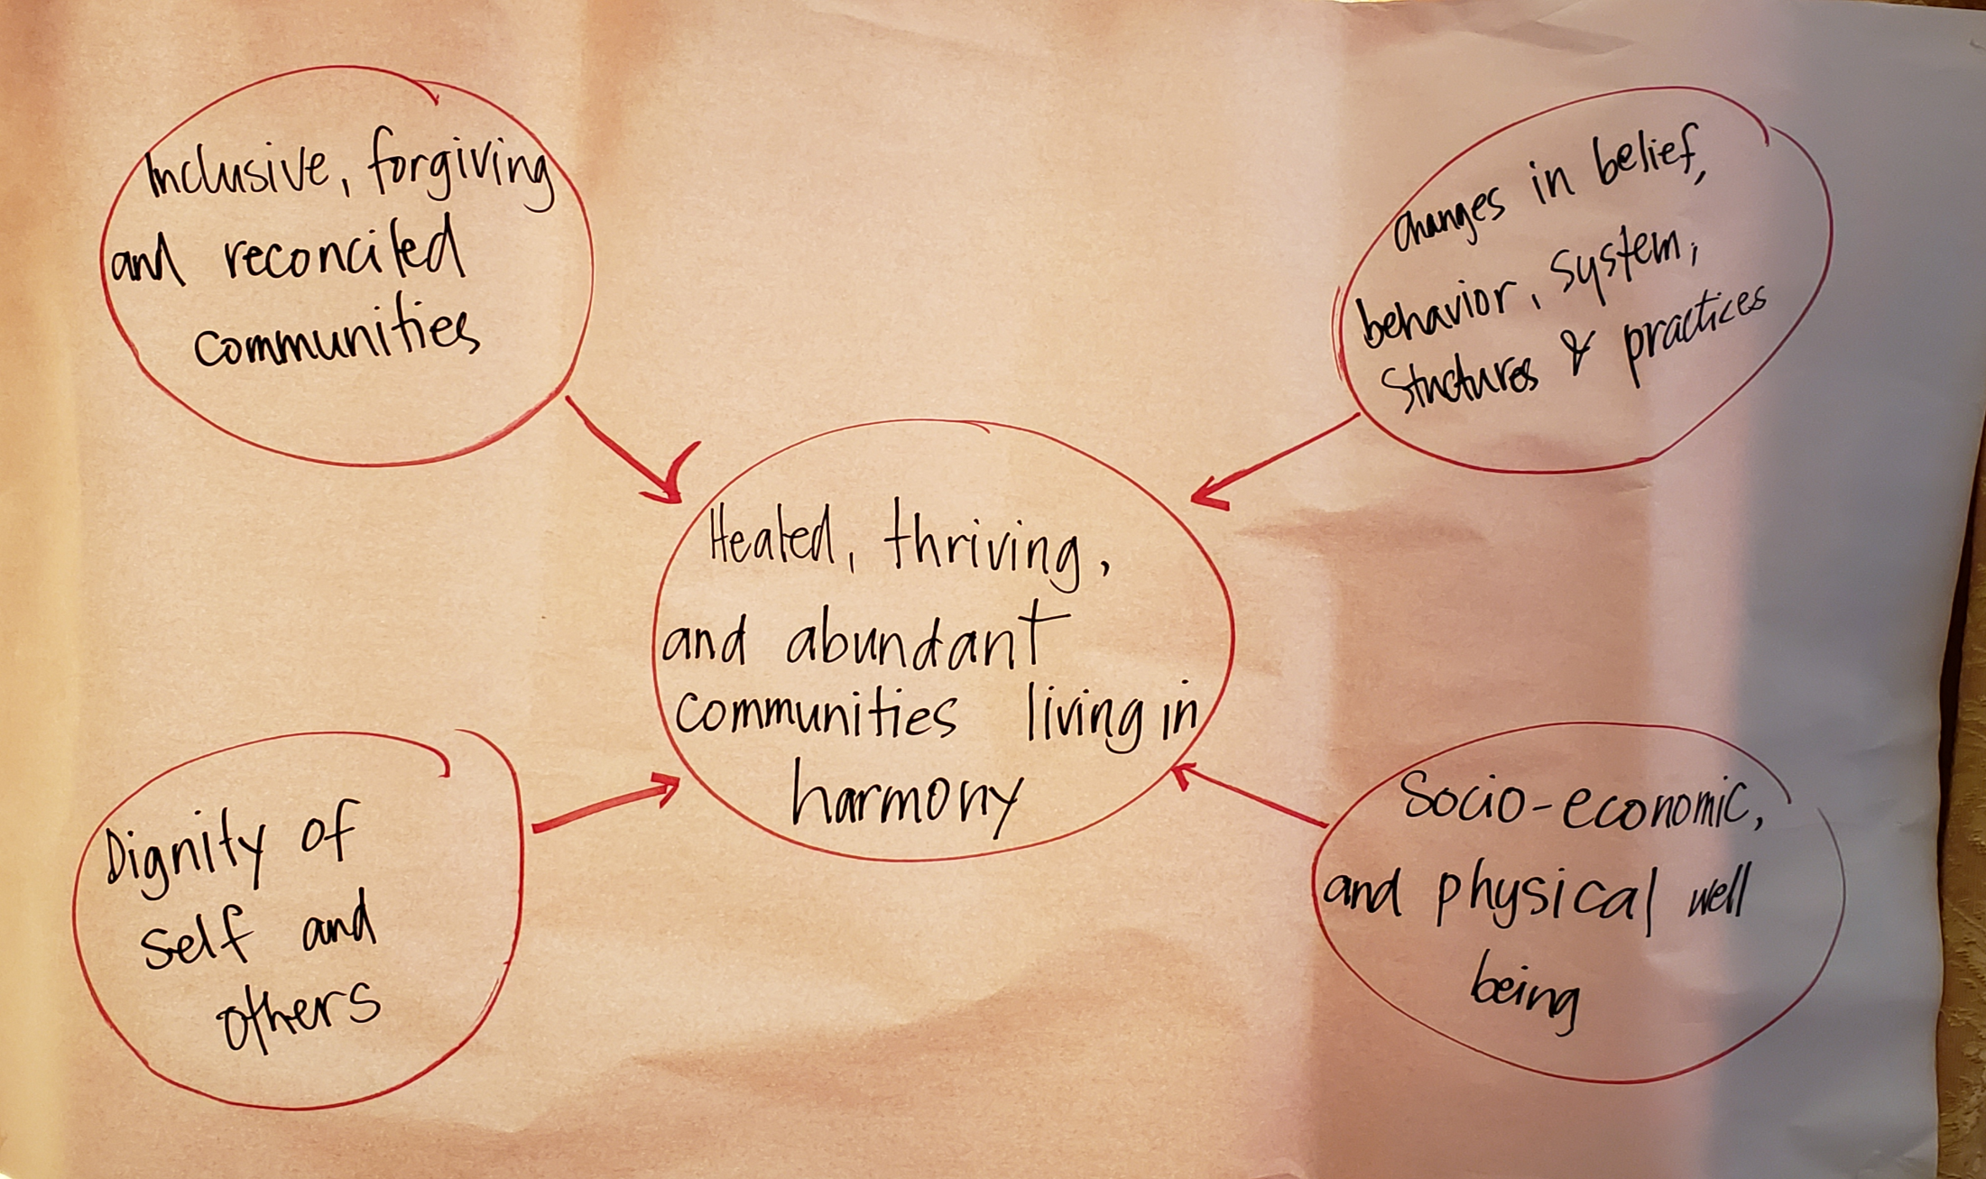
Vision of Success - Cambodia

Slide 27
Key Results
Improved rangeland management
Improved and sustainable use of natural water resources
Restored and preserved forest coverage
Sustainable agricultural practices
Sustainable use of energy
Sustainable management and protection of fresh water resources
Key Results
Inclusive participatory decision making process within and between communities
Inclusive and proactive conflict mitigation
Improved gender relations
Positive and healthy social norms
Enhanced household inter and intra community interaction
“Vision of Success” for FH Kenya
Restored and Sustained natural environment
Social Cohesion
Resilient and Peaceful communities with equal opportunities fulfilling their potential
Key Results
Enhanced capacity to meet essential needs during and after hazard
Reduced loss of productive assets
Robust market systems
Increased capacity of the government and community to prepare, mitigate risk and respond to shocks
Functional and Inclusive Economy
Key Results
Sustainable and diversified livelihood options
Strong market systems
Increased employability of the youth
Preparedness, Risk Mitigation and sustainably manage the impact of hazard
Key Results
Increased social accountability and transparency
Effective, efficient and sustainable social service delivery systems, processes and capacity
Responsive government structures at all levels
Effective policies/bills/acts/regulations in place to guide the government functioning
Pathways of change
Improved mental and physical health
Restored relationships, sense of purpose and life satisfaction
Availability and access to resources, safety and security
Optimal well being for all at every stage of life
Effective Governance

Slide 28
STRATEGY FRAMEWORK
VISION
PURPOSE
VALUES
3-YEAR STRATEGIC PRIORITIES
STRATEGY
OBJECTIVE A
OBJECTIVE B
OBJECTIVE C
PEOPLE
EXECUTION
CASH
ANNUAL
PLAN
FISCAL YEAR: ANNUAL TARGETS, PRIORITIZED ACTIVITIES & BUDGET GUIDELINES OF STRATEGIC PLAN
Notes:
Vision - ending all forms of human poverty worldwide
Purpose - Together we follow god’s call RESPONDING TO HUMAN SUFFERING and GRADUATING COMMUNITIES FROM EXTREME POVERTY
Values - our MO - we follow jesus, we work relationally, invest wisely and measure results, we serve with humality, we pursue beauty goodness and truth

Slide 29


TRANSFORMATIONAL
FRAMEWORK

Slide 30
Christian Mind in M&E - A Biblical Mandate
… no one will deceive you with well crafted arguments…. Don’t let any one capture you with high sounding nonsense that comes from human thinking… (Col. 2: 2-8)
Don’t copy the behavior and customs of this world, but let God transform you into a new person by changing the way you think. (Romans 12:2)
‘loving God with all your … mind’ (Matthew 22:36–38)

Slide 31
Challenging M&E Paradigm
What we believe and trust shapes our M&E paradigm. Every action that we take can be interpreted from the spiritual worldview
To do this, at the core, it is deepening of our spiritual character of our lives.
It begins with submission of our minds to the Lord of the universe- a willingness to be taught by Him.
The driving force in changing our world view to biblical worldview should be a commitment to “love the Lord your God with all your heart, soul, strength and mind.” (Lk. 10:27)

Slide 32

FH Definition of Transformation
Spirit driven radical change in the behaviors, attitudes, beliefs and worldviews of individuals, communities or cultures towards living in healthy relationships with God, others, self and creation.
Reconciliation of the 4 Relationships
God
Others
Self
Creation

Slide 33


COMPONENTS
We live in broken relationships. We are working towards reconciliation.
PRINCIPLES
OUTCOMES
APPROACHES

Slide 34
OUTCOMES
Wellbeing For All
Resilience
Transformed Leadership & Systems
Social Cohesion
Reconciliation of the 4 Relationships
Notes:
Subodh

Slide 35
Conclusion: Lessons in Building M&E Culture
Intentionally taking time to pause and reflect is critical to learning and improved program performance
Leaders are essential to creating a learning culture, the foundation of learning organizations
Evidence informed decision making is more likely to occur when decision makers themselves demand, define and interpret evidence
Encouraging Staff to ask questions and know why they need data and what they are going to do with the data:
  Art of asking the right questions
  Art of getting the right data
  Art of providing the right insight
  Art of facilitating adaptation

Slide 36
“If monitoring and evaluation is to be a credible partner in public and not-for-profit management, there will need to be a movement away from a singular focus on producing more and more one-off M&E reports and toward a synthesis and integration of M&E knowledge into management practices and policies.
It is the challenge of moving from believing the fundamental role for monitoring and evaluation in organizations is adversarial (throwing bigger and bigger stones) to M&E as facilitating organizational learning and improvement and knowledge building”
Mayne & Rist, 2006

Slide 37

THANK YOU!

