Slide 1

The Impact of Church and Community Mobilisation
Uganda case study
JLI Meeting
Dublin, 8-9th December 2016
Tim Raby (Country Representative, Uganda – Tearfund)
Michelle James (Bath Social & Development Research Ltd)

Slide 2
Background
A two-to-five year training programme to:
  Help churches understand the biblical mandate for integral/holistic mission
  Give them the confidence to work with their wider community to identify, prioritise and begin to address its needs using its resources
  Catalyse an iterative process of sustainable, holistic transformation
Used by Tearfund since the late 1990s and now implemented through a variety of local expressions which follow the same set of underlying principles and Theory of Change
Known in Uganda as PEP (the Participatory Evaluation Process) and taking place in c. 300 churches nationwide (mostly Pentecostal Assemblies of God)

Slide 3
Impact Assessment
Difficult because:
  Hard to measure holistic change
  Hard to ensure ownership
  Hard to understand attribution
Achieved through:
  Tearfund’s LIGHT Wheel – an attempt to describe the change we’re looking to see in 9 domains of life and steps on the journey towards it
  Household surveys – to understand the difference between those who do and do not self-report “involvement” in the process
  In-depth research on specific areas of impact e.g. improved governance and access to government-funded service
  QUIP

Slide 4
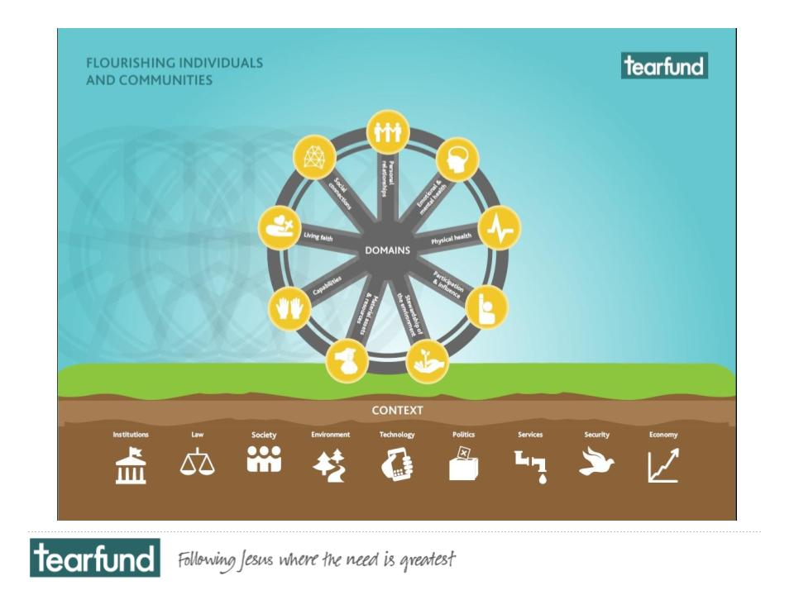

Slide 5
Bath Social & Development Research Ltd

Slide 6
Background to the QuIP
Assessing Rural Transformations – 3 year ESRC/DFID research project 2012-2015
Qualitative Impact Protocol – QuIP: tested in Ethiopia & Malawi on 4 different rural livelihoods projects.
Further development of QuIP through Bath SDR Ltd, applying the methodology to different projects.

Slide 7
Purpose of the QuIP
Simple, cost-effective evaluation tool
Useful in complex contexts
Records beneficiaries perceptions of the most significant drivers of change
No control group or baseline required
Unprompted feedback mitigates for bias
Structured and replicable
Notes:
Assessing Rural Transformations – set out to develop a simple, cost-effective and replicable, evaluation tool that could be used in complex rural contexts where a variety of factors may influence the intended outcomes of an intervention. It allows users to find out direct from beneficiaries what they perceive to the the most significant drivers of change in their lives, livelihoods and wellbeing – without the use of a control group or the need for a baseline.

Slide 8
Ten features of the QuIP
Data collection by independent field researchers without knowledge of the project (‘blindfolding’).
Purposive then random household sampling based on quantitative project monitoring.
Semi-structured household interviews plus focus groups.
Data collection instruments structured by wellbeing domain, with alternating open then closed question sections.
Data entry using pre-formatted Excel sheets to facilitate coding and analysis.
Notes:
1. One of the main features of the QUIP which stand out from other approaches; is the blinding of the field researchers. This is done in order to reduce confirmation bias as far as is possible. The researchers are recruited to undertake the study with full details of the research and the protocol, but with no information about the project or NGOs we were working with.
2. The QuIP uses purposive and then random household sampling, based on an agency’s existing quantitative project monitoring.
3. The field researchers carry out semi-structured household interviews, usually with a sample size of 24, plus 4 focus groups split by gender and age. In Tearfund’s case they chose to conduct a double QuIP, to cover the work of two partners in different parts of Uganda, so there were 48 interviews and 8 focus groups.
4. The QUIP questionnaires are ordered by domains of wellbeing, which are specific to each project but can include food production, consumption, income and expenditure, asset accumulation, relationships, overall wellbeing and in Tearfund’s case, Living Faith. The questionnaire uses a structure of open-ended, general questions about change over a set period of time, followed by closed questions.
5. The data is entered by the field researchers into a pre-formatted excel spreadsheet and sent to the lead analyst.

Slide 9
… continued
Systematic coding of impact evidence as explicit, implicit or incidental to project actions.
Additional flexible coding of drivers of change (positive and negative) and outcomes.
Rapid semi-automated report generation to speed analysis.
Easy to drill down from summary evidence to raw data for auditing and learning purposes.
Summary report, starting point for project level debriefing between project staff and researchers.
Notes:
6. The lead analyst (who knows the details of the projects and the theory of change) then codes the data according to a key from 1-9, seeking explicit or implicit, positive or negative reference to project interventions, or non-project related drivers of change.
7. The data is also ‘tagged’ with a description of the driver of change, looking for the root cause – the field researchers are trained to probe for this ‘attribution’ when asking the questions. Tearfund is the first agency to trial an additional level of tagging, where outcomes are also tagged alongside drivers, to try and build up causal chains.
8. The spreadsheet then produces tables which make up the basis of a simple report analysing the findings.
9. The QuIP producing both top level quantitative reports, useful for donors and communications, but also the ability to easily drill down from the summary findings to the raw data.
10. The report provides a starting point for project level debriefing and dialogue between project staff, researchers and beneficiary groups.

Slide 10
Case Study: Tearfund Uganda CCM
4 communities in Kitgum & Soroti
2 partners conducting CCM for varying timeframe in each community
12 household interviews in each community (purposive sample based on those known to have taken part in CCM (Participatory Evaluation Process (PEP))
2 focus groups in each community
Lead Field researcher recruited by Bath SDR from a Ugandan university, other field researchers recruited in-country based on their experience and language skills
10 days of open-ended, exploratory interviews

Slide 11
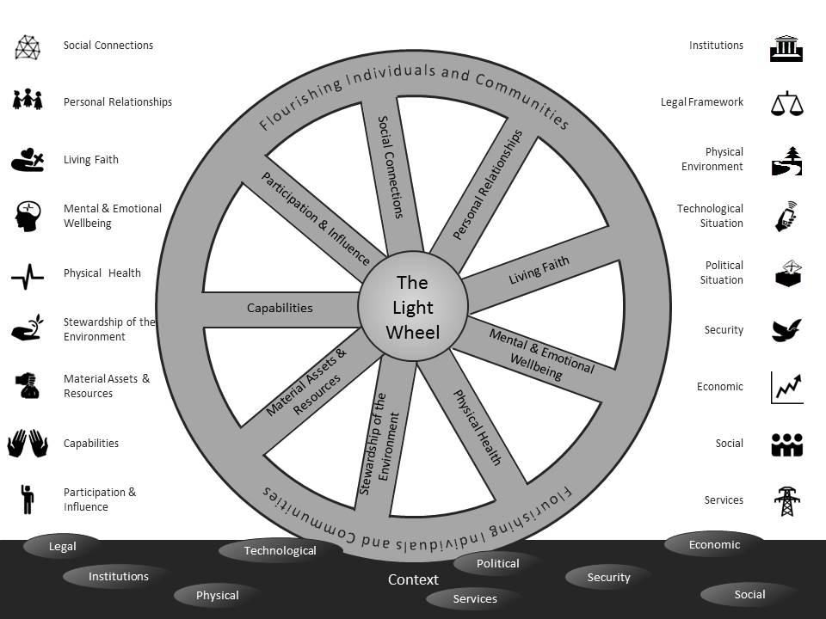
Designing the Questionnaire
Food production
Cash Income
Expenditure
Relationship: Family & Community
Overall wellbeing
Living Faith
Links to External Organisation
Notes:
Worked with Tearfund to design questionnaire domains that fitted around their ‘Light Wheel’ wellbeing framework.
The questionnaire was then piloted in Uganda, refined and then the field researchers went and conducted the interviews.

Slide 12
QuIP Research Concerns
Less tangible outcomes – hope, self-confidence, restored relationships - will the QuIP pick these up?
Community/individual-led change vs externally driven projects – causal chains, will interviewees link changes to CCM intervention?
Can we maintain the blinding in communities where guides needed to be used?

Slide 13
QuIP Early Findings
Ranked External Organisations
HOUSEHOLDS | 1 | 2 | 3 | 4 | 5 | 6 | 7 | 8 | Total rankings
World Vision | 9 | 7 | 3 | 0 | 3 | 0 | 0 | 0 | 22
VSLA | 2 | 1 | 6 | 5 | 3 | 2 | 0 | 0 | 19
PEP | 6 | 4 | 1 | 3 | 1 | 1 | 0 | 0 | 16
Church of Uganda | 13 | 1 | 1 | 0 | 0 | 1 | 0 | 0 | 16
NAADS | 1 | 4 | 2 | 1 | 2 | 0 | 0 | 0 | 10
PAG | 3 | 2 | 1 | 1 | 1 | 1 | 0 | 0 | 9
LWF | 1 | 1 | 5 | 1 | 0 | 0 | 0 | 0 | 8
SERUDA | 2 | 1 | 1 | 0 | 1 | 1 | 1 | 0 | 7
Send a Cow | 2 | 3 | 1 | 0 | 0 | 1 | 0 | 0 | 7
AVSI | 2 | 3 | 0 | 1 | 0 | 0 | 0 | 0 | 6
TIP | 0 | 1 | 0 | 3 | 0 | 0 | 1 | 0 | 5
RALNUC | 0 | 0 | 2 | 1 | 1 | 1 | 0 | 0 | 5
NUSAF | 0 | 2 | 1 | 0 | 1 | 0 | 0 | 0 | 4
KIWEPI | 0 | 2 | 0 | 0 | 1 | 0 | 0 | 0 | 3
TASO | 0 | 0 | 2 | 1 | 0 | 0 | 0 | 0 | 3
Africare | 0 | 0 | 0 | 0 | 1 | 1 | 0 | 1 | 3
PEP, PAG, Church of Uganda: 41 references (60 including village saving groups)
Notes:
Only the household data has so far been coded

Slide 14
QuIP Early Findings
Closed Question Responses
Negative Drivers
Unpredictable weather, drought, floods.
Poor soil health/disease.
Cost of education
 | Ability to produce food | Happy with way produced | How much food eaten | Income | Control and choice over source of income | Purchasing power | Value of assets | Control and choice over expenditure | Community relations and decision-making | Wellbeing
AN01 | + | + | + | + | + | + | + | + | + | +
AN02 | - | - | - | - | - | - | - | - | = | -
AN03 | + | + | + | + | + | + | + | + | + | +
AN04 | - | - | - | - | + | - | + | + | + | +
AN05 | - | - | - | - | + | - | - | + | = | -
AN06 | + | - | + | + | + | + | + | + | + | +
AN07 | - | - | - | = | + | - | + | = | + | +
AN08 | + | = | - | - | - | + | + | + | + | +
AN09 | - | - | = | + | + | + | + | = | = | +
AN10 | - | - | = | - | - | - | - | - | + | -
AN11 | - | - | - | - | + | - | - | + | + | +
AN12 | - | - | - | - | + | - | - | + | + | -
KW01 | - | - | - | + | + | + | + | + | + | +
KW02 | - | - | - | - | - | - | - | = | + | +
KW03 | - | - | - | - | - | - | - | - | + | -
KW04 | - | - | - | - | - | + | + | + | + | +
KW05 | - | - | = | - | - | - | - | - | + | +
KW06 | - | - | - | - | - | - | - | - | + | -
KW07 | - | - | - | - | - | + | + | + | + | +
KW08 | - | - | - | - | - | - | - | - | + | +
KW09 | - | - | - | - | - | - | - | - | = | -
KW10 | - | - | - | + | + | - | - | - | + | -
KW11 | - | - | - | - | = | - | - | - | + | +
LB01 | - | - | - | - | - | - | - | - | + | -
LB02 | = | - | = | + | + | = | = | = | = | +
LB03 | - | - | - | + | + | = | = | = | + | +
LB04 | - | - | - | - | - | - | - | - | + | +
LB05 | = | - | = | + | + | + | = | = | + | +
LB06 | + | + | + | + | + |  | + |  | + | +
LB07 | + | + | + | + | + | + | + | + | + | +
LB08 | + | + | + | + | + | + | + | + | + | +
LB09 | - | - | - | + | + | + | + |  | + | +
LB10 | - | - | - | + | + | = | - | = | + | +
LB11 | + | + | + | + | + | + | + | + | + | +
LB12 | + | + | = | = | = | - | - | - | = | +
LB13 | + | + | - |  |  |  | + | + | + | +
OM01 | = | - | = | + | + | - | = | = | - | +
OM02 | - | - | - | + | = | + | + | + | = | +
OM03 | - | - | - | - | - | - | + | + | - | =
OM04 | = | + | - | - | = | - | + | = | + | +
OM05 | = | + | = | - | - | = | + | + | + | +
OM06 | + | + | + | + | + | - | + | + | + | +
OM07 | + | + | - | - | - | - | - | - | + | -
OM08 | - | - | - | - | - | - | + | - | + | +
OM09 | + | + | + | + | + | - | + | + | + | +
OM10 | - | - | - | - | = | - | = | = | + | +
OM11 | + | + | + | + | + | + | + | + | + | +
OM12 | - | - | - | - | - | - | - | - | + | -
Positive Drivers
Farming improvements
Diversification of livelihoods
PEP (CCM)
Human Rights training
Climate change mitigation
Savings groups
Christianity/church involvement/interfaith collaboration
Notes:
Negative Drivers – unpredictable weather, drought, floods, poor soil health and disease (ludwar weed), cassava rot, cost of education crippling people, selling assets to pay for schooling, but then unable to farm so effectively because they have sold their ox or land.
Positive Drivers
Farming improvements – cash crops, livestock rearing, better agricultural techniques – ox plough
Diversification of livelihoods – cash crops, boda bodas, opening a shop
Climate change mitigation – tree planting, manuring, living fence, drought resistant crops

Slide 15
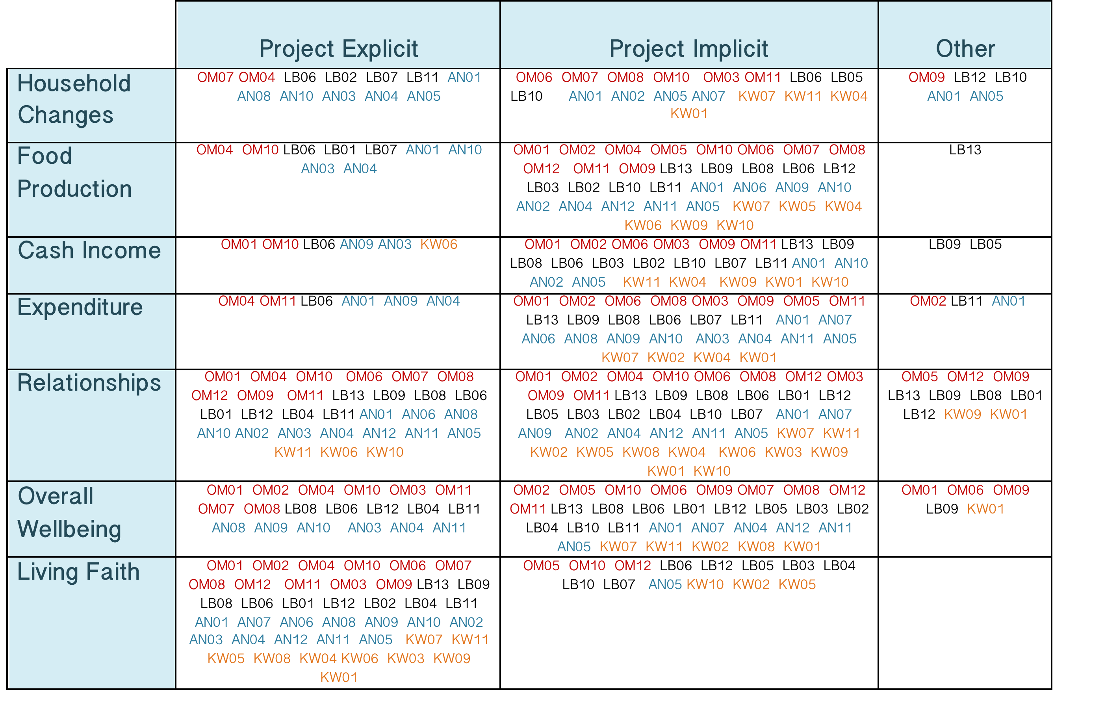
QuIP Early Findings
Frequency count of positive changes reported by households
Notes:
This shows the number of households that report a positive story of change in a given domain. You can see that a significant number explicitly reference either a Tearfund partner or the CCM initiative in some way in their answer, and many more implicitly reference CCM by linking their story of change to an intervention known to have been initiated by CCM, for example, they may say that they had been to counselling on family relations, but without naming who conducted the counselling.

Slide 16
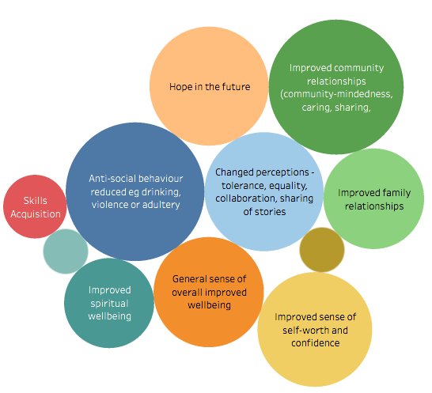
Driver of Change:
Increased involvement/participation with church – bible study, conferences, preaching, praying
QuIP Early Findings:
e.g. Positive causal relationship
Notes:
19 households said it had led to a reduction in anti-social behaviour, 18 improved community relationships, 14 that it had positively changed perceptions within the community (gender equality etc) and 14 that it had increased their hope for the future.

Slide 17
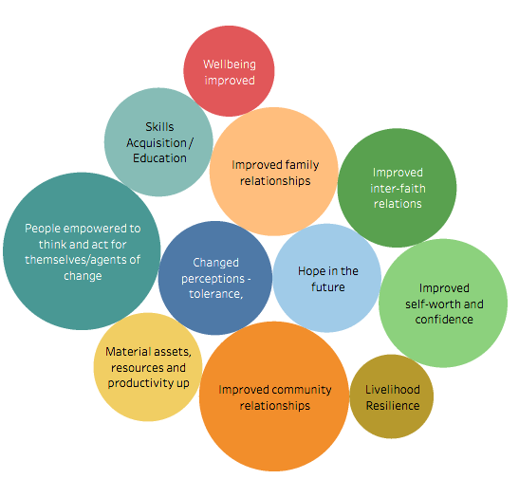
Driver of Change:
PEP Interventions
QuIP Early Findings:
e.g. Positive causal relationship
Notes:
Empowerment (21), improved community relationships (19), sense of self-worth (14), improved family relationships (14), improved inter-faith relationships (12)

Slide 18
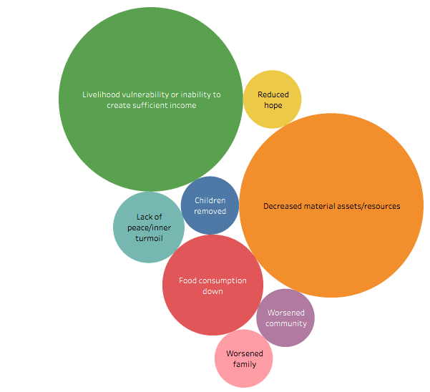
Driver of Change:
Practice of sending children to private school
QuIP Early Findings:
e.g. Negative causal relationship
Notes:
40 households cited the increased cost of education as having a negative impact on their material assets/resources and having increased their livelihood vulnerability in the last 5 years. This was sometime extreme, for example they may have sold their livestock or land just to pay for private school fees, meaning they have sold their means of income.

Slide 19
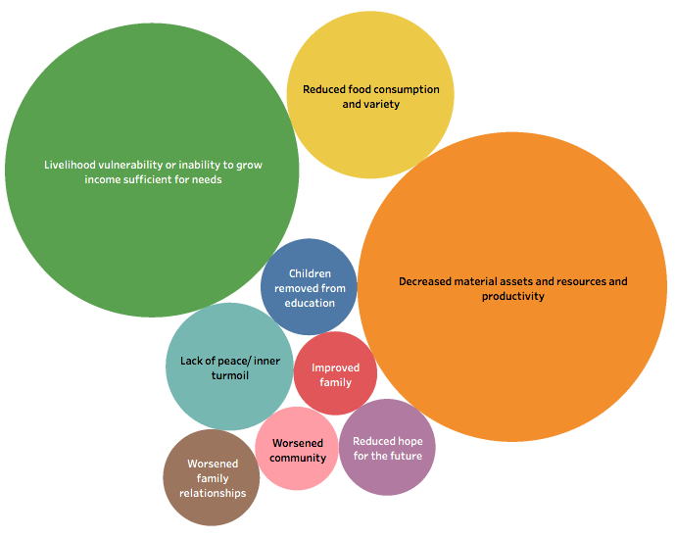
Driver of Change:
Climate change & poor soil health
QuIP Early Findings:
e.g. Negative causal relationship
Notes:
41 - decreased material assets
37 – livelihood vulnerability
12 – reduced food consumption

Slide 20
CCM QuIP Concluding Remarks
The QuIP tested the CCM theory of change against the reported, lived reality of intended beneficiaries.
The data can be split into key drivers of change and their associated positive and negative outcomes, highlighting any differences between communities/demographics.
We found unprompted positive references to CCM or the local church as drivers of change, leading to: improved relationships, livelihood resilience, empowerment, changed perceptions and helping to mitigate potentially worse negative outcomes.
Negative drivers of change give a more detailed picture of the challenges communities face to help future planning.
It will be used as an organisational learning tool to build on successes, question gaps, help pick up on complexity and unforeseen impacts, as well as understanding the role of other actors.
Notes:
Organisation learning tool - what else is going on in the lives of our beneficiaries that may positively or negatively affect our interventions intended outcomes? Are there unforeseen impacts of our intervention, positive or negative? What other actors are in the locality, and how is their intervention impacting the community?

