Slide 1
World Vision Partnership Approach to Building Evidence

Slide 2
Goal | Sustained well-being of children within families and communities, especially the most vulnerable
Aspirations | Girls & Boys:
 | Enjoy good health | Are educated for life | Experience love of God and their neighbours | Are cared for, protected and participating
Outcomes | Children are well nourished | Children read, write, and use numeracy skills | Children grow in their awareness and experience of God’s love in an environment that recognises their freedom | Children cared for in a loving, safe, family and community environment with safe places to play
 | Children protected from infection, disease, and injury | Children make good judgments, can protect themselves, manage emotions, and communicate ideas | Children enjoy positive relationships with peers, family, and community members | Parents or caregivers provide well for their children
 | Children and their caregivers access essential health services | Adolescents ready for economic opportunity | Children value and care for others and their environment | Children celebrated and registered at birth
 |  | Children access and complete basic education | Children have hope and vision for the future | Children are respected participants in decisions that affect their lives
Foundational Principles | Children are citizens and their rights and dignity are upheld (including girls and boys of all religions and ethnicities, any HIV status, and those with disabilities)
Notes:
Knowing what to measure. For WV, it’s been a clarifying journey to develop our CWB Aspirations and Outcomes.

Slide 3
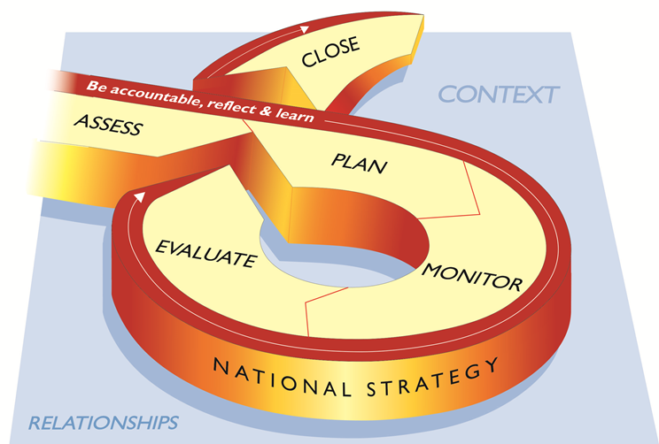
LEAP Programme Cycle
Notes:
The LEAP cycle looks similar but has been simplified. Project management is now included in the document.
Assess - The national office will prepare a feasibility assessment for any new area programmes that they intend to open during the strategy period. This gives the national office the opportunity to review the child well-being needs and opportunities in the new programming areas and see how well these match the national office’s strategy and capacity. Completed and approved feasibility assessments form the basis of an agreement between national offices and funding office to fund a new area programme.
Plan - The purpose of planning is to develop logical plans for technical programmes, area programmes and shared projects that are jointly owned by the community and partners and that will contribute to the sustained well-being of children. In LEAP 3rd Edition, planning leads to Technical Programme Designs and Consolidated Area Programme Plans.
Monitor - Monitoring will be strengthened substantially, with emphasis on outcome monitoring. Technical programmes will deliver semi-annual and annual reports
Area programmes will deliver annual reports with much higher quality data and more compelling stories of change in children’s lives directly from children and the community; semi-annual reporting no longer required.
Evaluate – Baseline and evaluation will be done for technical programmes, sampling from all relevant area programmes. Evaluation data contributes to an evidence base that enables WV and its partners to Improve programme effectiveness by asking what’s working, what’s not working and why to inform future choices and programme plans and to Increase accountability by sharing evaluation results in appropriate ways with all key stakeholders, including communities, partners, host governments, and donors. Evaluations will also provide important opportunities to improve the sustainability of programmes. By ensuring the drivers of sustainability are measured and by working jointly with local partners and communities at all stages of the evaluation.
Close - It is important that WV ends its involvement in a well-planned way, so that the benefits gained by communities and stakeholders can be continued into the future, after WV has withdrawn. In order to end well, a plan needs to be in place from the beginning of the programme, showing how WV will phase out of the shared programme in a way that promotes sustainability. Communities and partners need to be well prepared for the eventual withdrawal of World Vision, and the process of withdrawal needs to be well planned and mutually agreed.
Project management - The discipline of planning, organising, securing and managing resources to achieve specific goals is now included as a core component in LEAP. The purpose of project management is to provide staff with the skills and tools necessary to manage programming across. whole programming cycle. Good project management allows us to meet project goals and objectives within scope, time, and budget.

Slide 4
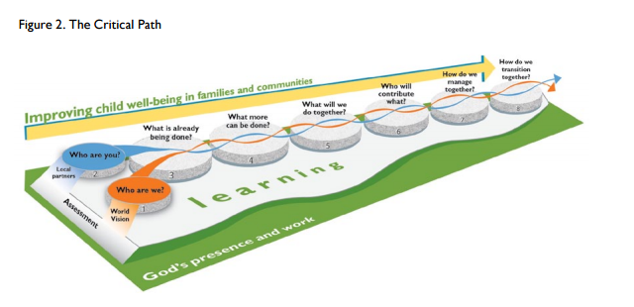
How We Work
Notes:
Our work with and in communities is guided by our Faith. It drives how we see and engage communities. It should drive us to be better partners with communities and to treat them with greater respect and dignity. This also influences what we do, as well as what and how we measure it.

Slide 5
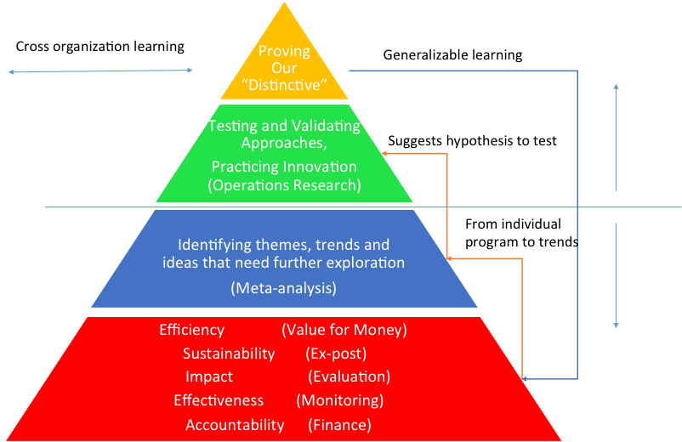
Research & Learning: Where we fit

