Slide 1
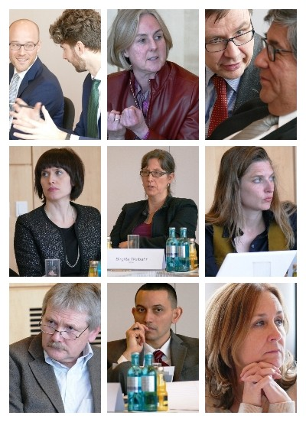
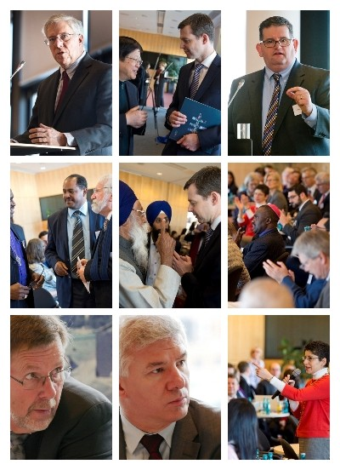
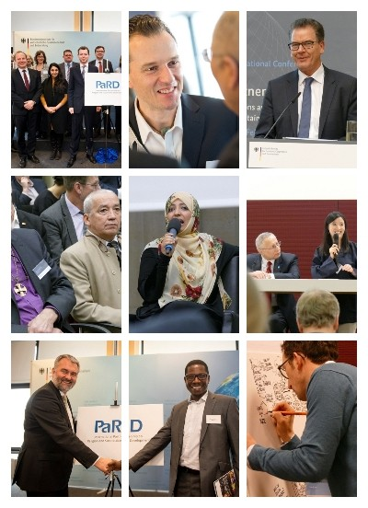

Slide 2
International Partnership on Religion and Sustainable Development (PaRD) Constituting Meeting Key Outcomes 16.2.2016 Berlin

Slide 3
PaRD Mission statement
PaRD brings together bilateral donors and multilateral development partners who seek to effectively engage with religious communities and organsations to achieve the goals of the 2030 Agenda on Sustainable Development.
A close collaboration with civil society is key to PaRD. Therefore, religious organisations, faith-based and community initiatives, foundations, academia and other networks can become associated partners.

Slide 4
PaRD
PaRD provides space for exchanging ideas and policy strategies for government and multilateral actors and donors (policy dialogue).
It identifies political and practical needs and gaps and matches them with existing expertise.
It is not a funding mechanism or an umbrella organisation.

Slide 5
PaRD
By means of knowledge sharing, joint strategy development and project piloting, and by building on existing initiatives and networks, PaRD contributes towards a more coherent and effective international agenda on religion and development.
PaRD has a strong focus on results and implements concrete activities in the following areas of cooperation:
Knowledge Sharing/Learning Exchange
Networking/Dialogue
Capacity Building
Policy Advice

Slide 6
Guiding principles of PaRD
Relevance: focus on Agenda 2030 and implementation of SDGs
Human Rights: commitment to the Universal Declaration of Human Rights and Human Rights standards, and to equality (i.a. women, indigenous people, marginalised groups)
Respect: mutual respect for religious, secular and scientific results
Inclusivity: diversity in regional, sectoral, religious and gender representation (“leaving no one behind”)
Reciprocity: agreement to not only benefit from PaRD but also to contribute own expertise

Slide 7
Guiding principles of PaRD
Shared responsibility for outcomes: transparent governance structure and decision making procedures
Guarantee of intellectual ownership: rests with the member/partner contributing to PaRD
Bridge builder: considers the knowledge of existing governmental and civil society initiatives
Non-profit-making: programmes, products and publications developed jointly have no commercial purpose and are available to all members and partners
Self-reflexivity: regular critical review of work and outcomes

Slide 8
Form of membership
Membership is voluntary and open to all established and new bilateral donor countries and multilateral organisations.
Level of commitment and priority areas lie in the responsibility of the respective member/partner.
There are three levels of engagement:
1. Core-funding members are bilateral or multilaterals that commit to finance the PaRD secretariat and activities.
2. Members are bilateral or multilaterals that make in-kind contributions (e.g. knowledge sharing), finance single activities and joint projects according to their capabilities and priority areas.
3. Associated partners are non-governmental actors, including religious organisations, foundations, academia and other networks and initiatives that make in-kind contributions (e.g. knowledge sharing), finance single activities and joint projects according to their capabilities and priority areas.

Slide 9
Decision making
Members decide on key issues related to PaRD including the annual working programme.
The inputs from associated partners are considered before taking decisions.
Members take decision based on consensus and not on majority of votes. Each organisation is expected to come up with one agreed position if possible.

Slide 10
Annual meeting
During the annual meeting the progress of the annual working programme (successes and challenges) are discussed and evaluated.
In the first part consultations with the associated partners take place. In the second part members take decisions on the working programme while considering the input from the associated partners.
Each year a different member hosts the annual meeting.

Slide 11
Current PaRD members and partners
Core-funding members:
BMZ, USAID
Members:
DFID, SIDA, UNDP, UNWOMEN, Unicef, UNFPA, UNAIDS, OGPRtoP, The World Bank
Intended members:
Deza, Norad, GAC, MinBuZa, ILO, OECD, EuropeAid -> Letters of Intent (LOI) expected
Intended associated partners:
identification of partners is currently ongoing

Slide 12
Areas of cooperation and activities (priorities 2016 based on voting, including added vote of DFID)
Area of Cooperation | Activities | Comments
1. Knowledge sharing / Learning exchange | Sharing of best practices on how to prevent human rights violations and gender discrimination: 8
 | Collecting and sharing guidance notes (and their roll out and application): 4 | Screening of political strategies on religion and development
 | Glossary of key terms and terminology: 2+1
 | Offer: methodology for youth employment: 0

Slide 13
Areas of cooperation and activities
Area of Cooperation | Activities | Comments
2. Networking / Dialogue | Strengthening coordination regarding ROs engagement at country level on SDG implementation: 8 | Using Religious actors-Country-Mapping and identifying gaps
 | Facilitate dialogue, especially on sensitive issues linked to sexuality and gender equality: 5+1
 | Offer: Methodologies and processes for interreligious dialogue on decent work (SDG 8): 0

Slide 14
Areas of cooperation and activities
Area of Cooperation | Activities | Comments
3. Capacity Building, e.g. religious literacy | Religious literacy module: 7
 | Religious actors-country-mapping and identifying gaps: 7+1
 | Joint programming to build capacities of FBOs to address SDG areas: 0

Slide 15
Areas of cooperation and activities
Area of Cooperation | Activities | Comments
4. Policy advice | Share experiences and lessons learned on integrating religions and religious actors into policy making processes: 7+1
 | Gap analysis on SDGs‘ intersection with religion: 3
 | Identify priorities for policy advice: 2

Slide 16
Areas of cooperation and activities
Area of Cooperation | Activities | Comments
5. Others | Identifying and creating a platform for female religious leaders/women of religion: 9+1
 | Implementing joint pilots: 3 | According to screening of specific sectors and regions
 | Developing a communication strategy for religion and development: 1

Slide 17
Cooperation with existing initiatives and activities
PaRD does not intend to invent the wheel again or replace existing initiatives.
UN DUF’s main task is to offer a global policy round table under aegis of the UN and create a safe space that operates under Chatham House Rules. DUF will continue to exist and its key conveners will ensure coordination with PaRD through close contact with the secretariat and active engagement in the development of the annual programme.
To ensure coordination with World Bank’s and ROs Moral Imperative (MI) Initiative, PaRD will be represented in the MI Steering Committee (SC) as an observer.

Slide 18
Criterias for selecting RO
Focus on issues relevant to Agenda 2030: development, humanitarian assistance, peace, interreligious dialogue
Commitment to the Universal Declaration of Human Rights / Human Rights Standards, and to equality (i.a. women, indigenous people, other marginalised groups)
Impartiality towards target groups
No proselytism with ODA or other public funds
Transparency and accountability
Check of track-record of intended associated partner and past working relationships with PaRD members
No listing in official listings of banned people / organisations:
http://www.state.gov/j/ct/rls/other/des/143210.htm
http://eur-lex.europa.eu/legal-content/EN/TXT/PDF/?uri=CELEX:32015D1334&qid=1440691334018&from=EN

Slide 19
How ROs can become associated partner
RO with expertise in the fields of development, humanitarian assistance, peace, interreligious dialogue can become associated partners
Letter of intent based on standardised online application form stating:
background of RO, expertise and existing collaborations
areas of intended cooperation and form of contribution
focal point of organisation or initiative
Applications are evaluated by the secretariat against the selection criteria and put forward with a recommendation to all members for a final decision.

Slide 20
Mandate of the secretariat
PaRD is supported by an international secretariat at GIZ in Bonn and Berlin: It is supervised by the core-funding members, and:
provides analytical competency for policy formulation and dialogue on religion and development.
coordinates the implementation of the annual working programme and activities (needs assessments, country assessment on religion, capacity building tools, joint piloting).
assists through knowledge management and logistical support.
initiates cooperation with new donors, members and associated partners.
does public relations and communication on activities and successes (website, event calendar, social media, newsletter etc.).
facilitates publications and studies.

Slide 21
Results of evaluation
The evaluation forms of the constituting meeting indicate that:
the meeting was overall successful.
the organisation of the event and logistical support for the participants was very good.
there was too little time for detailed discussions.
there was too little space for participants to give presentations.

Slide 22
Results of evaluation

Slide 23
Next meeting
Oktober or November 2016
Host: USAID
Venue: Washington, date tbc.
Website: www.partner-religion-development.org
Email: info@partner-religion-development.org

