Slide 1
The Foreign & Commonwealth Office and International We Will Speak Out Coalition against sexual violence Interfaith Consultation Meeting
9th and 10th February 2015
Mobilizing Faith Communities in Ending Sexual Violence in Conflict
Sally Smith UNAIDS
Notes:
Thanks to organizers for organizing this follow up meeting to the ground breaking summit held last June:
UK Government & the Foreign & Commonwealth Office- William Hague
Archbishop of Canterbury- representing the WWSO coalition.
I am particularly pleased to be speaking on this panel to represent UNAIDS, as we have journeyed with this initiative and the WWSO coalition on this journey since its’ launch
Thank you especially to the religious leaders and FBOs, many of whom have travelled so far to join us today- and who are doing some very difficult and courageous work in your countries

Slide 2
Violence, abuse and exploitation:
increasing risk and vulnerability
In some settings, up to 45% of adolescent girls report that their first sexual experience was forced.
Young women who experience intimate partner violence are 50% more likely to acquire HIV than women who have not.
Source: Multi-country study on women’s health and domestic violence against women.
Geneva: World Health Organization; 2005.
Notes:
We are all here because of a very clear problem- sexual violence and for UNAIDS the very significant link between sexual violence and HIV, which is exacerbated in situations of humanitarian crisis and conflict.
The elimination of gender based violence is prioritised in the UNAIDS Strategy 2011-2015 as critical to ending AIDS by 2030.
Globally, in median 1 in 5 ever-married or partnered young women 15-24 has experienced physical or sexual violence by a partner in the last 12 months.
The proportion of women survivors of physical and/or sexual violence who seek help ranges from 18% in Azerbaijan and the Philippines to 52% in Colombia.
A study in South Africa found that young women who experienced intimate partner violence were 50% more likely to have acquired HIV than women who had not experienced violence (Jewkes et al. 2010. Lancet)
According to WHO, women exposed to IPV are 1.5 times more likely to acquire HIV then women who have not experienced (IPV). Please see iconographic.
Sexual violence is increased in situations of conflict- rape is used as a weapon of war, and due to social unrest and power inequities, more women resort to sex work and transactional sex to survive* World J Public Health Sciences 2014;3(1):13 Kasangye et al., 2014. Public Health Implications of Sexual Violence in DRC

Slide 3
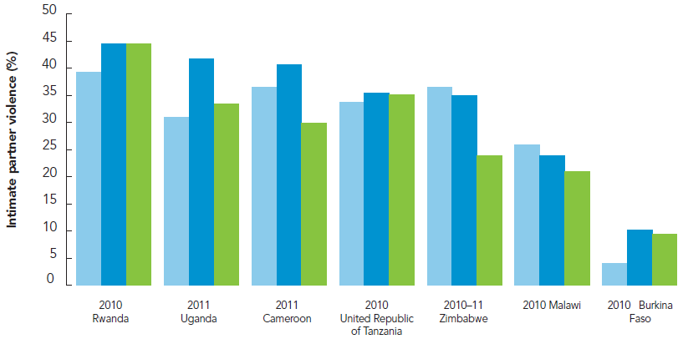
Percentage of ever-married women who have experienced
spousal physical or sexual violence by their current or most
recent husband or partner in the past 12 months, by age
Source: Demographic and Health Survey data, countries with available data in sub-Saharan Africa.
Notes:
In median, approximately 1 in 3 ever-married or partnered adolescent girls 15-19 and young women 20-24 in sub-Saharan African countries has experienced physical or sexual violence by a partner in the last 12 months.
In 16 sub-Saharan African countries young women 15-24 report higher prevalence of recent IPV than women 25-49
Around 120 million girls worldwide (slightly more than 1 in 10) have experienced forced intercourse or other forced sexual acts at some point in their lives. (Hidden in Plaint sight, UNICEF, 2014)

Slide 4
UN Security Council Resolutions and Follow up Action
The UN Security Council Resolutions 1308, 1325, 1820 and 1983 all speak to sexual violence, conflict and HIV.
UNAIDS strategic actions in partnership with UN:
Advocacy, coordination and partnerships
Strategic information
Quality technical support and capacity building
Advocacy for sustainable funding
Notes:
Historical Resolution 1038 in 2000- first time health and social development issue (AIDS) addressed by Security Council
2005- resolution 1325 recommended greater attention to gender and HIV- further cooperation between DPKO and UNAIDS
2008 resolution1820 demanded end to sexual violence against citizens .. Noting that rape and other forms of sexual violence cam constitute a war crime
2011- resolution 1983 called for urgent and coordinated action to curb the impact of HIV in conflict and post conflict situations.
The UNSG will report on conflict related sexual violence in March 2015. Key themes in this report are expected to include:
Rising violent extremism and sexual violence as a tool of terror
Sanctions and accountability
The risks facing refugees and IDPs- in urban and camp settings, and land rights for women
Children born of wartime rape, sexual violence against men and boys.

Slide 5
Sexual Violence and HIV in DRC and S. Sudan
A nation-wide survey in 2011 found that approximately 1.69 to 1.80 million women reported having been raped in their lifetime in DRC
Women aged 15 and up living with HIV 220 000 [190,000 - 260,000] in DRC (UNAIDS 2012)
A survey conducted in Juba, Morobo and Rumbek, showed that 51% of women in households in Juba had suffered gender based violence. In Morobo, 37% of women in households had ever been abused, including 21% who had had forced sex. (2012/3)
Women aged 15 and up living with HIV 79,000 [30,000 - 180,000] in S. Sudan (UNAIDS 2012)
Notes:
Reference for bullet 1.) (Peterman A. et al. Estimates and Determinants of Sexual Violence Against Women in the Democratic Republic of Congo, 2011 American Journal of Public Health;Jun2011, Vol. 101 Issue 6, p1060)
Reference for bullet 3) (South Sudan Global AIDS Response Progress Report 2013. Reporting Period 2012-2013)
Report from UNAIDS country office 2015: Enfin la prévalence globale du VIH dans la province du Sud kivu est inférieure à la moyenne nationale : 0,4% versus 1,2% alors qu’elle est estimée à environ 2% chez les femmes victimes de violences sexuelles.
UNAIDS interventions in conflict settings in South Sudan, Mali, Central African Republic; DRC have:
Secured HIV services & reduce vulnerabilities of refugees and Internally Displaced Persons (IDPs) in conflict, post conflict as well as fragile environments
Engaged military, Police and peacekeepers as agents for change in reducing risks of HIV transmission among civilians and combatants.
Addressed sexual & gender-based violence (SGBV) by taking steps to protect vulnerable women and girls and in the event of abuse ensure access to post exposure prophylaxis

Slide 6
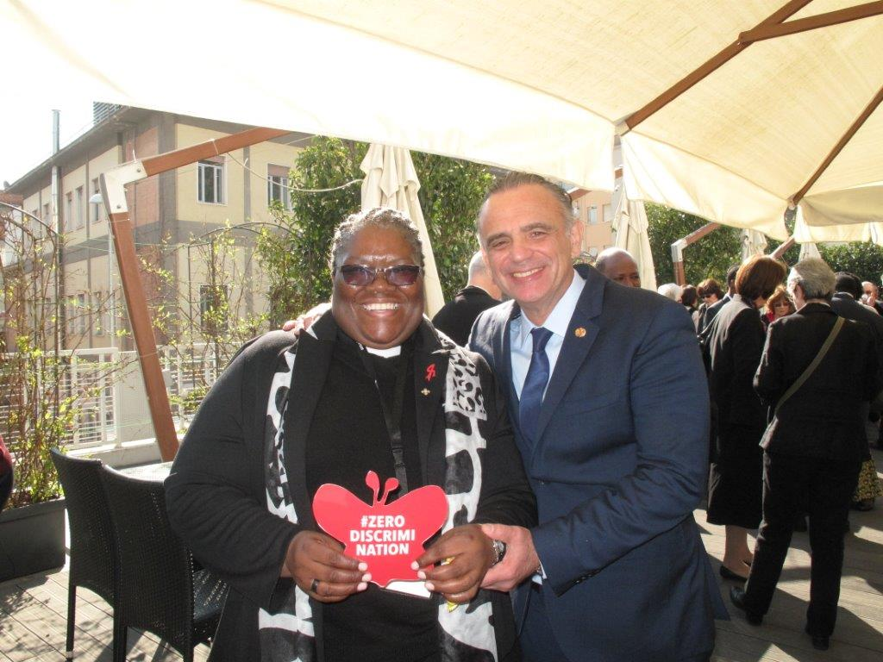
Role of Faith Leaders as defenders of values of faith and human rights.
Notes:
UNAIDS collaboration with Faith leaders, communities is a key strategy to addressing discrimination & violation of human rights, including sexual violence.
UNAIDS has been engaged in the launch & formation of faith based national coalitions of the ‘We will speak out” against sexual violence in 6 countries:
-Liberia,
- DRC
- Burundi
- Rwanda
- South. Africa and
PNG
Approaches to partnership with FBOs to strengthen their role as defenders of values of faith and human rights include:
1) ADVOCACY
UNAIDS has conducted high level advocacy with FBOs at national and international levels:
meetings & world AIDS day video with Archbishop’s Justin, Thabo and Bernhard
an Op-ed prepared by UNAIDS EXD and the former Archbishop of Canterbury.
Participation in the Summit last year- and this event today

Slide 7
Not in my name
Notes:
2.) Advocacy with religious leaders to secure robust language in international declarations supportive of values of faith and human rights
UNFPA led in collaboration with UNAIDS, a dialogue with religious leaders and FBO representatives in New York, on the side-lines of the General Assembly in September 2014, which resulted in a powerful declaration calling for world leaders to ensure stronger action on sexual health in the post-2015 development agenda, and challenging the use of religion as a reason to hold back progress on these critical issues as the quotation below demonstrates:
“Not in our name should any mother die while giving birth. Not in our name should any girl, boy, woman or man be abused, violated, or killed. Not in our name should a girl child be deprived of her education, be married, be harmed or abused. Not in our name should anyone be denied access to basic health care, nor should a child or an adolescent be denied knowledge of and care for her/his body. Not in our name should any person be denied their human rights.
We affirm that sexual and reproductive health are part of human rights, and as such, must be guaranteed by governments. We note in particular the importance of preventing gender-based discrimination, violence and harmful practices; upholding gender justice; ensuring that every pregnancy is wanted and that every birth is safe; providing age-appropriate sexuality education; promoting the health, education and participation of youth and adolescents; preventing, treating and caring for people with HIV/AIDS; supporting family planning; and respecting the human body.”

Slide 8
Framework for Dialogue
Notes:
3) Development of Tools and resources on faith and human rights.
A tool- which provides the mechanism for religious leaders and networks of people living with HIV to have dialogue on HIV, stigma and discrimination, human rights – stress the importance of bringing religious leaders together with survivors to listen first hand to their experiences and advice.
UNAIDS supported WWSO coalition in similar approaches-and in the shaping of the work plan and strategy along similar lines
In addition :Three international consultations on religious faith and human rights have been held in collaboration with EAA/GNP+ and INERELA + to explore the intersections between theology and human rights in the context of HIV, to develop a mutual understanding of the common values underlying human rights, and to articulate practical consequences for further and deeper collaboration in the struggle against HIV
The next step is to publish a resource book on human rights and faith in the context of HIV to promote further reflection on the issues in a wider variety of settings, particularly in national dialogue settings between religious leaders and people living with HIV. The articles should equip religious leaders (both lay and ordained), as well as activists and people responding to HIV on the ground who find themselves in contentious debate to understand historical linkages between human rights and religion, personal realities, and the potential for transformative justice in combining religious faith and human rights approaches

Slide 9
So much more to be done…
“Silence in the face of evil is itself evil:
God will not hold us guiltless
Not to speak is to speak not to act is to act”
Deitrich Bonhoeffer
Notes:
How to respond when traditional interpretations of faith and culture fly in the face of Human Rights? - Prophets are not always popular with the authorities.
UNAIDS Country Director Catherine Sozi challenged the National Church Leaders of S. Africa Meeting on 15 October 2013: Her speech,
More than a prayer: Your response to sexual violence and HIV, is a powerful challenge to every religious leader- and parent.
A question often asked by victims of sexual violence – who do we turn to? Do I turn to my priest? Would he be receptive if I turned to him for support? How will he react when he hears the rapist is my husband? Those who have been sexually assaulted suffer in silence due to the stigma associated with the crime.
There is no doubt that it takes more than prayer to heal and empower girls and women who have endured sexual violence—to transform them from victims to survivors. It takes compassionate leadership that reaches beyond scripture and traditional rites and teachings.
In situations of conflict those who commit acts of sexual violence are more often strangers than known to the survivor
In many countries however those ‘creepy men’ we warn our daughters about are known to them.
So let's take a quick look at these "creepy men." Who are they, really? Who are the creepy men that are making it unsafe for your daughter, your wife, your sister, to go solo to the shops, even to a party on campus?
Who are these "creepy men" and where did they come from AND who raised them?
They are young or old men that your daughter, sister, wife, mother probably knows and interacts with. You cannot build a wall up around your daughter, sister, wife, mother to keep these men from entering her world -- they are already inside it.
As for who raised them? The answer, unfortunately, is me, you; its US.
I don't expect you to welcome what I am saying. I doubt many of you will even accept it. I want you to know that I'm not saying all boys and men are rapists or disrespectful of women -- and I'm certainly not saying that all boys and men are just wired that way.
What I am saying is this: we live in a culture that puts victims on trial with questions like, "well, what were you wearing?" and "how much did you drink?"
We live in a culture where a mother or father, concerned about raising sons who "act honourably", holds young women accountable for the way young men objectify them. We live in a culture where a judge hands down a 30-day sentence to a rapist because his 14-year-old victim was "older than her chronological age." “she looked older than her age”…..We live in a culture that relegates not getting raped to women and girls instead of expecting and demanding boys and men to be responsible for not raping. I, personally, have heard that in my church and have challenged my priest.
What I am saying is that we reap what we sow. And because of the proximity that the church has to its people, I wonder if we have had the “don’t rape” conversation with our sons, our nephews, our youth groups, our men’s clubs, our seminary students in the training colleges, ourselves……that this is wrong!
When you have the "avoid getting raped" conversation with your daughter, your sister, your aunt, it is difficult, as you don't want to imagine her as a victim.
The idea of having the "don't rape" conversation with your son, your nephew, your brother, your uncle, your male congregation is more difficult as you don't ever want to imagine him as a perpetrator.
But I would like to suggest that you do it anyway.

Slide 10
Female sex workers reporting work-related violence (%)
Notes:
Marginalized women- such as sex workers and transgender women experience sexual violence and increased rates of HIV infection as a result- this is exacerbated in situations of conflict.
In 110 countries with available data, the prevalence of HIV infection is almost 12 times higher among sex workers than for the population as a whole, with prevalence at least 50-fold higher in four countries.
Even in very high prevalence countries, HIV prevalence among sex workers is much higher than among the general population. An analysis of 16 countries in sub-Saharan Africa in 2012 showed a pooled prevalence of more than 37% among sex workers.
In Nigeria and Ghana, HIV prevalence among sex workers is 8-fold higher than for the rest of the population
Addressing and reducing violence against sex workers has the potential to reduce HIV transmission. Modelling estimates in two different epidemic contexts—Kenya and Ukraine—show that a reduction of approximately 25% in HIV infections among sex workers may be achieved when physical or sexual violence is reduced.
In addition, power imbalances that make girls and women disproportionately vulnerable to HIV become even more pronounced during conflicts and displacement. There may be increased pressure to engage in sex work. HIV risk among sex workers and their clients may be increased due to lower condom use and increased violence.

Slide 11
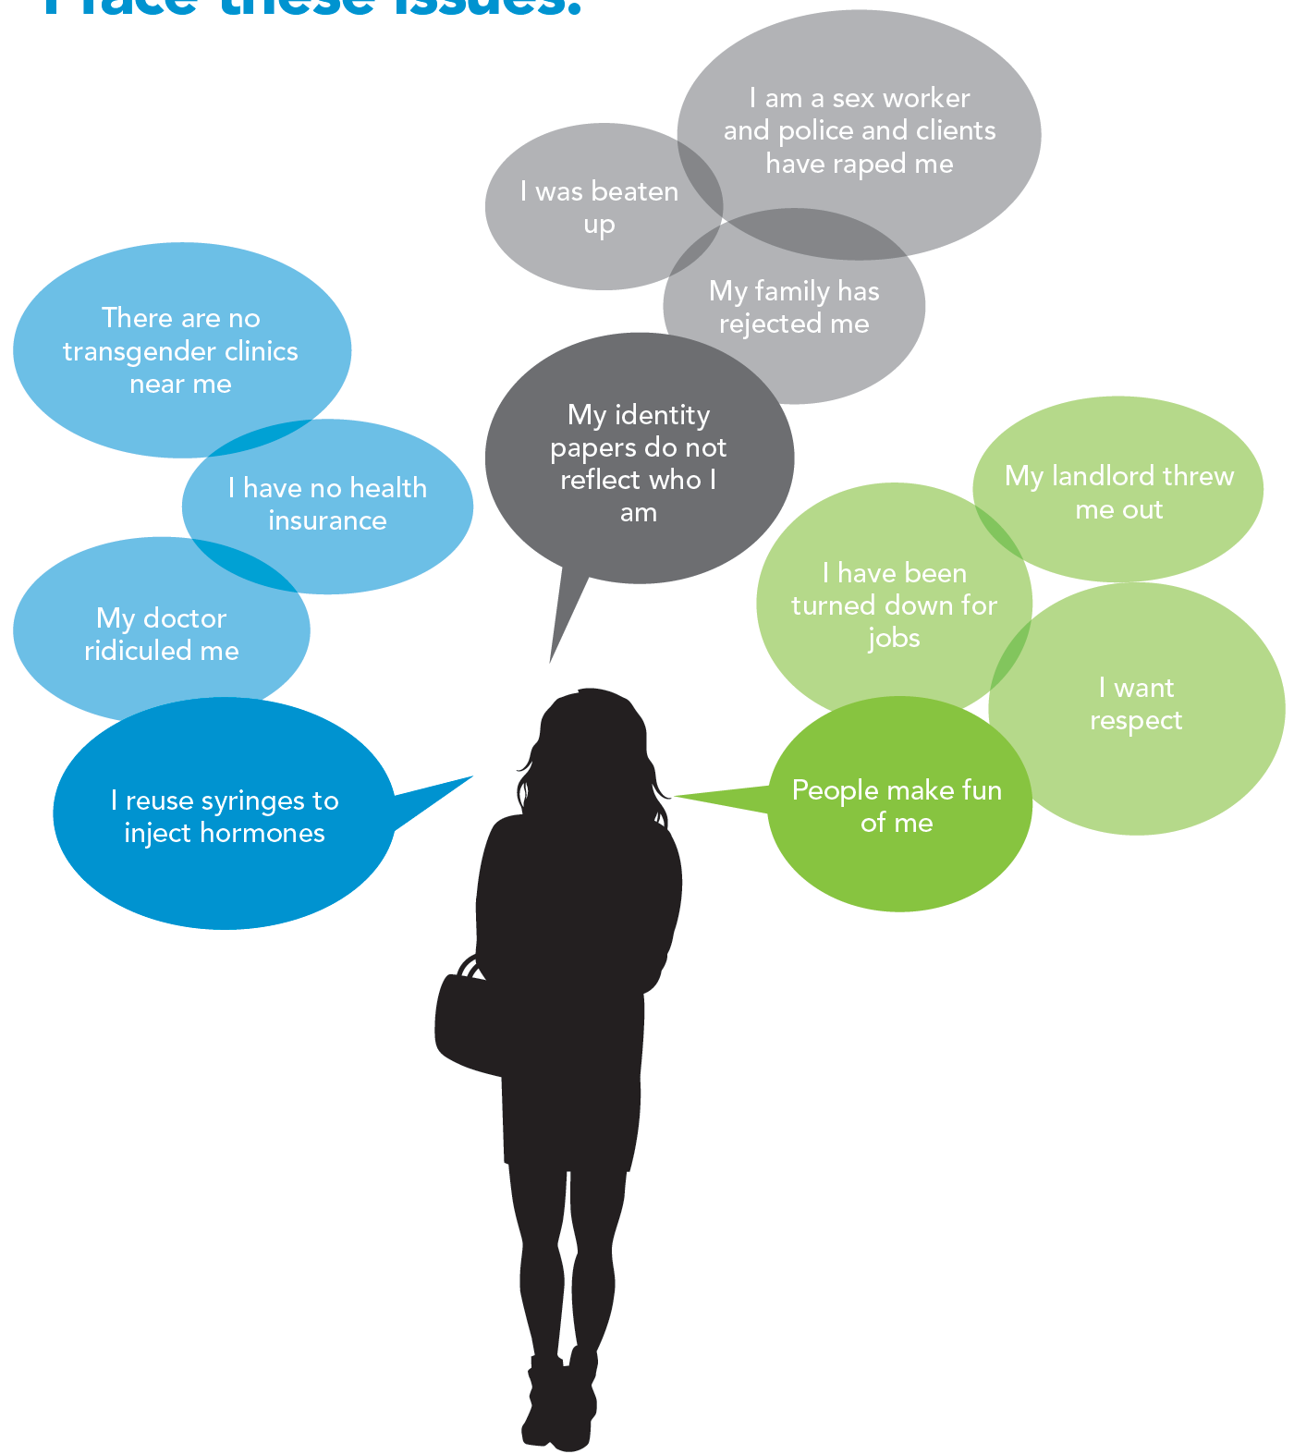
I am a transgender woman.
I face these issues.
Notes:
Transgender women are among the populations most heavily affected by HIV.
Globally, an estimated 19% of transgender women are living with HIV.
Globally, the chance of acquiring HIV is 49 times higher for transgender women than all adults of reproductive age.
Estimates suggest that the transgender population could be between 0.1% and 1.1% of reproductive age adults.
Country reports suggest that HIV prevalence for transgender sex workers is on average nine times higher than for female sex workers and three times higher than for male sex workers

Slide 12
Additional Resources and References.
Women living with HIV speak out against violence http://www.unaids.org/en/resources/documents/2014/womenlivingwithhivspeakout
UNAIDS GAP Report-http://www.unaids.org/sites/default/files/en/media/unaids/contentassets/documents/unaidspublication/2014/UNAIDS_Gap_report_en.pdf
Fast Track Report http://www.unaids.org/sites/default/files/media_asset/JC2686_WAD2014report_en.pdf
Global Plan to eliminate new HIV infections in Children and keep mothers alive http://www.unaids.org/sites/default/files/media_asset/20110609_JC2137_Global-Plan-Elimination-HIV-Children_en_0.pdf

