Slide 1
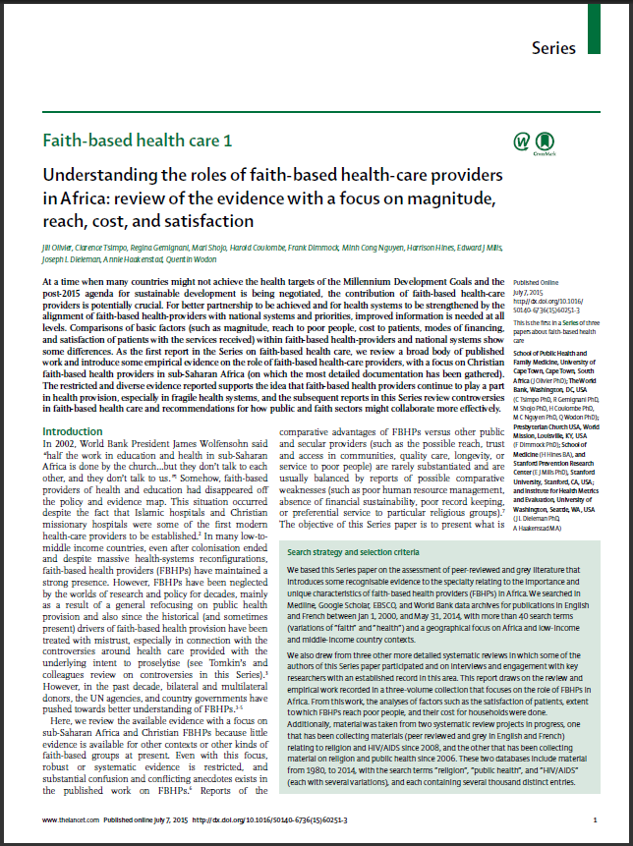
Understanding the roles of faith-based health-care providers
in Africa:
Review of the evidence with a focus on magnitude, reach, cost, and satisfaction
Jill Olivier, Clarence Tsimpo, Regina Gemignani, Mari Shojo, Harold Coulombe, Frank Dimmock, Minh Cong Nguyen, Harrison Hines, Edward J Mills, Joseph L Dieleman, Annie Haakenstad, Quentin Wodon

Slide 2
Often Problematic Data Gaps & Estimates
"Half the work in education and health in sub-Saharan Africa is done by the church … but they don't talk to each other, and they don't talk to us"
(James Wolfensohn, WB, 2002)
“In many African countries, you provide 30 to 70% of the health services and in post-conflict countries, the majority of primary education services”
(Graeme Wheeler, WB, 2010)
Notes:
At a time when many countries might not achieve the health targets of the Millennium Development Goals and the
post-2015 agenda for sustainable development is being negotiated, the contribution of faith-based health-care
providers is potentially crucial.
For better partnership to be achieved and for health systems to be strengthened by the
alignment of faith-based health-providers with national systems and priorities, improved information is needed at all
levels.
There is little systematic and similar data is available relating to faith-based, non-profit health providers

Slide 3
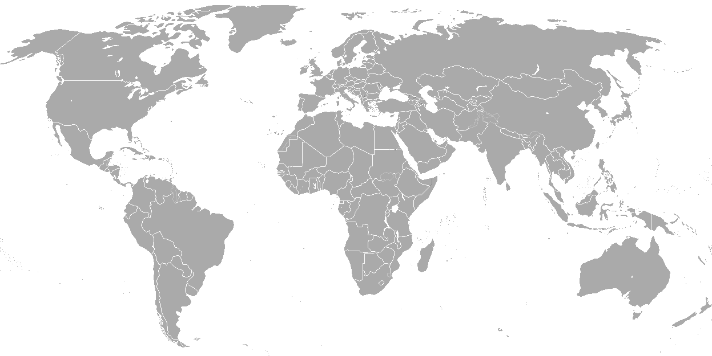
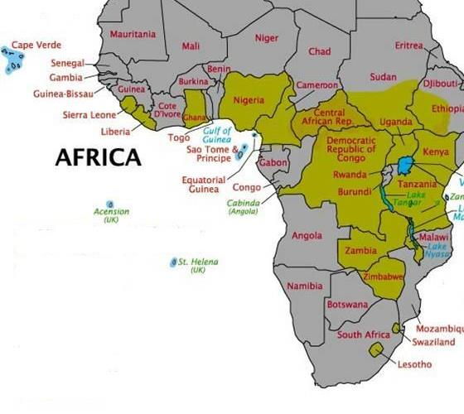
(Biomedical) FB health providers in Africa

Slide 4
Country | Self-declared NFBHN share (beds) | NFBHN hospitals | NFBHN health Centers | NFBHN training facilities
Benin | 40% | 6 | 20 | 28
Botswana | 18% | 2 | 6 | 2
Cameroon | 40% | 30 | 150 | 3
CAR | 20% | 2 | 62 | 19
Chad | 20% | 4 | 164 | 2
DRC | 50% | 89 | 600 | 20
Ghana | 42% | 58 | 104 | 10
Kenya | 40% | 74 | 808 | 24
Lesotho | 40% | 8 | 72 | 4
Liberia | 10% | 6 | 67 | 3
Malawi | 37% | 27 | 142 | 10
Nigeria | 40% | 147 | 2747 | 28
Tanzania | 42% | 89 | 815 | 24
Togo | 20% | 3 | 39 | 0
Uganda | 40% | 47 | 541 | 19
Zambia | 40% | 36 | 110 | 9
Zimbabwe | 35% | 80 | 46 | 15
E.g. Estimates of market share of FBNPs vs public health system
Note: based on hospital beds and facilities
Note: e.g. of African countries with more substantial share

Slide 5
(More) Useful to Look at:
Access, Utilization, Cost, Satisfaction, Reach to Poor etc…
Data from household surveys suggest lower market shares than commonly assumed…
But higher levels of satisfaction than in public facilities
Faith-based health providers play an important part in many countries in Africa, particularly in fragile or weakened health systems

Slide 6
(More) Useful to look at:
Appreciation tempered by awareness of controversies of faith-based social engagement and lingering weakness (of some FBHPs) irt quality and adaptability to health systems conditions (eg financial constraints)
All broad generalisations about faith-based organisations or the faith sector should be avoided
Health systems research is necessary (eg: that unpacks how exactly FBHPs contribute/don’t to UHC at a country level
More detailed policy implementation strategies for improved PPP/engagement with FBHPs are needed

