Slide 1

**DRAFT**
All Faiths United
for a healthy, prosperous, & malaria free
Mozambique!

Slide 2
What is PIRCOM?
Goal: Recruit, organize, train, and equip religious leaders in 4 provinces to educate their communities about prevention and treatment of malaria
Create national scale religious coordinating mechanism
Advocate at national level for malaria eradication
Partnership with Ministry of Health, funded by USAID, Mozambican businesses

Slide 3
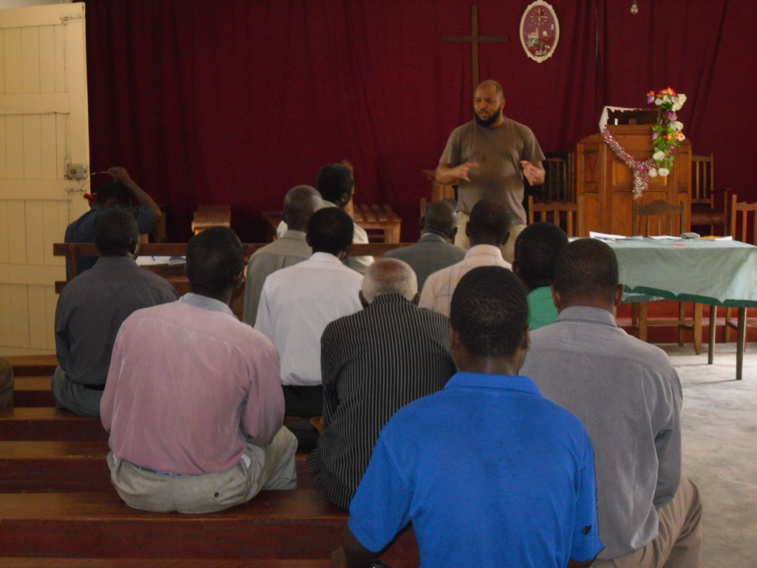
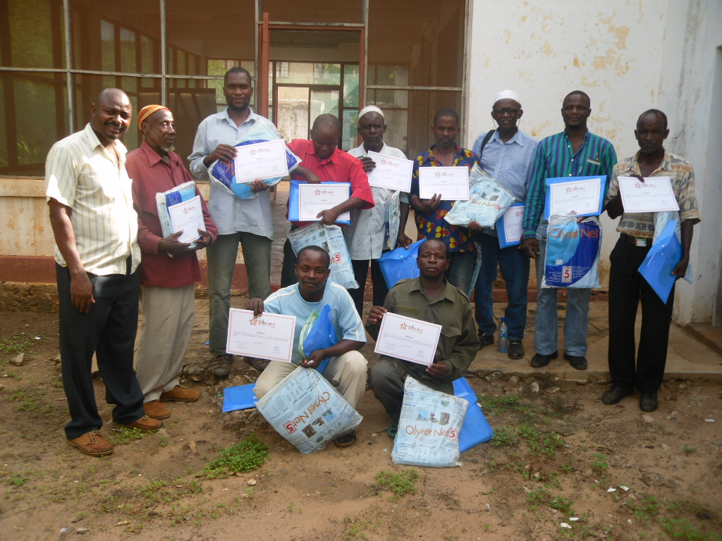
Faith leaders training faith leaders and educating their communities
Mussajy Remane, Coordinator of PIRCOM in Sofala province training Faith Leaders in a Church in Sofala
Pastor Hermínio Guifutela, Coordinator of PIRCOM in Nampula province training Christian and Muslim Faith Leaders in Nampula .

Slide 4
Results
Creation of 4 provincial PIRCOMs reflecting local religious presence
Multi-religious cascade training model from province to district to local faith leader
More than 27,000 faith leaders trained reaching million members of faith communities
In 2012, 556 new faith leaders were trained as trainers reaching more than 54,000 people.

Slide 5
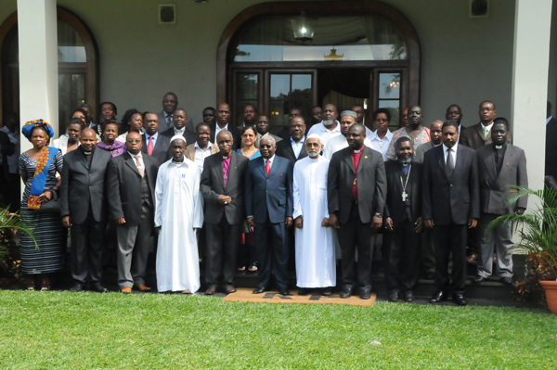
Advocacy
PIRCOM faith Leaders meeting with President Armando Guebuza, and Minister of Health Dr Franscico Manguel, March 22, 2012 at Ponta Vermelha
Notes:
PIRCOM faith Leaders meeting with President Armando Guebuza, and Minister of Health Dr Franscico Manguel, March 22, 2012 at Ponta Vermelha
Photo credit: Armando Munguambe

Slide 6
Lessons Learned
Faith networks built for malaria can be used for other public and primary health concerns, such as TB, Cholera etc
Friendship and common cause was developed across faith lines by working together
Challenges of sustainable financing

Slide 7
Recommendations
Adapt faith networks built for malaria to other public and primary health concerns, such as TB, Cholera etc
Develop mechanisms for multi-sector investment including public and faith based institutions

Slide 8
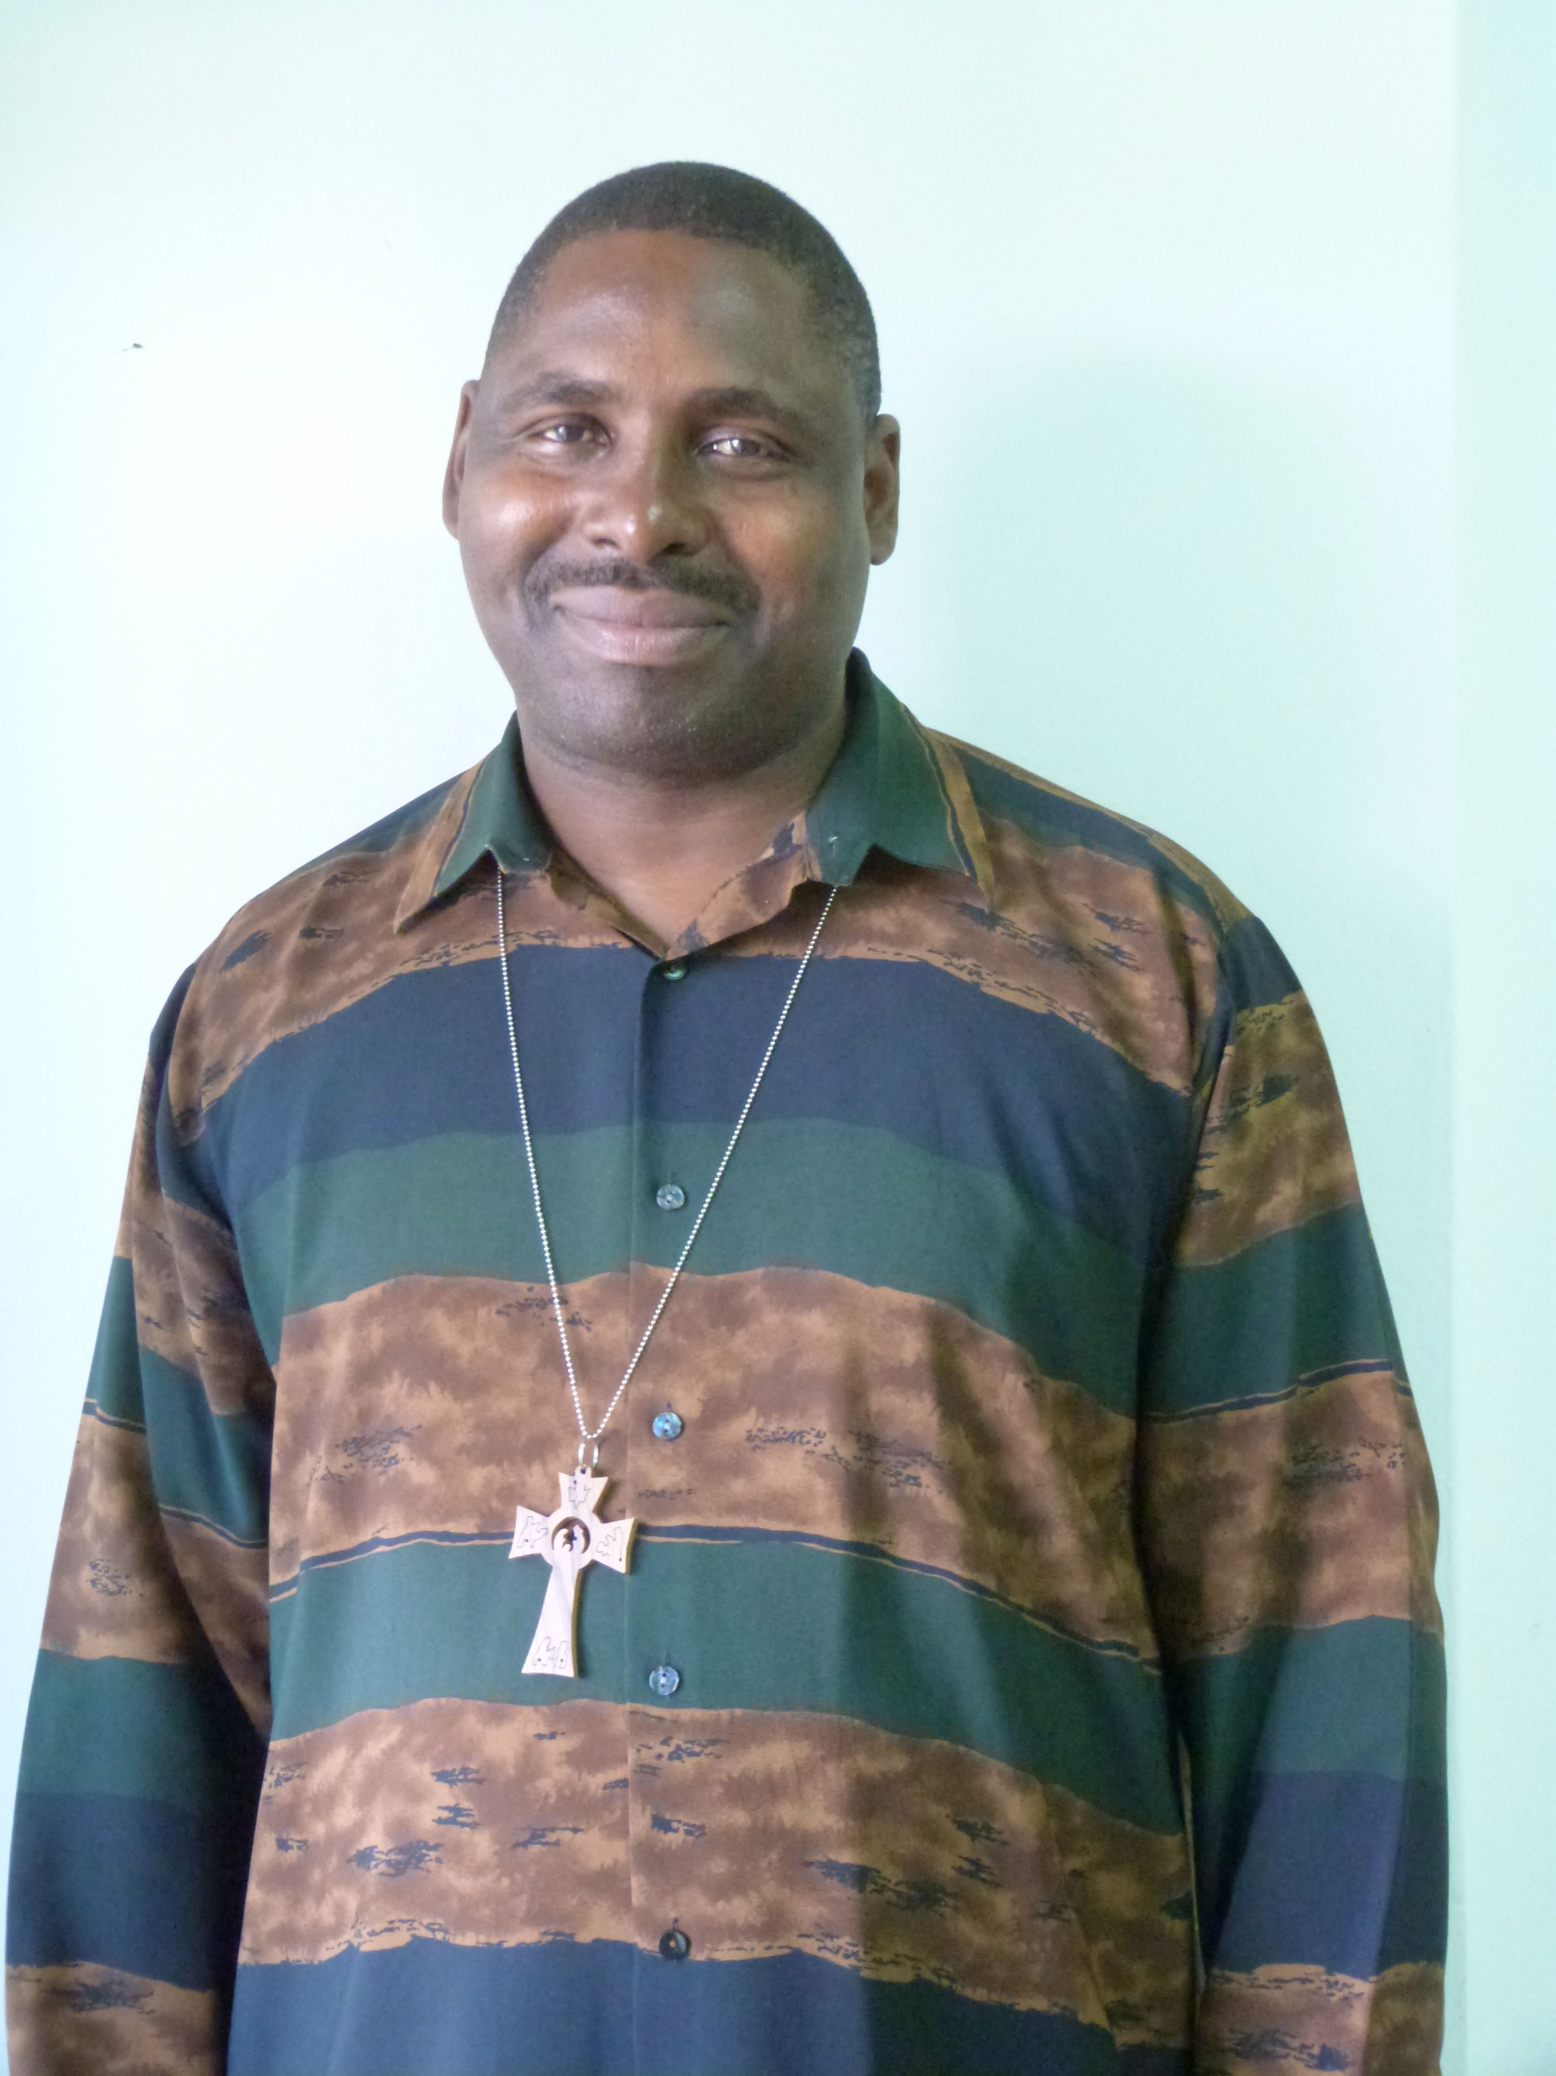
For more information about PIRCOM
PIRCOM Invitation To Partnership
Bishop Dinis Matsolo,
PIRCOM Executive Director
Bishop Dinis Matsolo
Executive Director
PIRCOM Av. Karl Marks # 1982 2dto
Maputo Mozambique
Tel: +258 21 320070
Fax: +258 21 320071
Cell: +258 82 307 0991
email: info@pircom
www.pircom.org
Photo J Duff

