Slide 1
International Care Ministries– Case Study Evidence on Programs of Contributions of LFCs to Community Development and Humanitarian Needs
Lincoln Lau, Director of Research

Slide 2
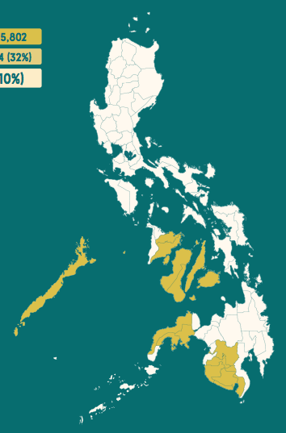
Background
International Care Ministries (ICM) is a faith-based NGO in the Philippines
Core program is an adult education-based poverty alleviation intervention called Transform
Target are households living in ‘ultrapoverty’ defined as <$0.50 USD per person per day
Approximately 1,000 communities of 30 households receive this program annually
~30,000 households per year

Slide 3
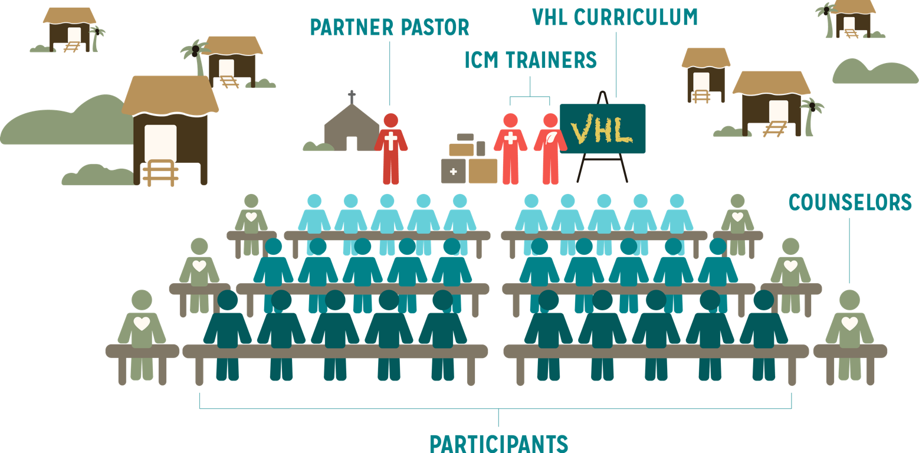
Transform Program
Communities of 30 households
975 Communities scheduled to receive VHL in 2016-2017

Slide 4
Sample Studies conducted by ICM Research
Randomized Controlled Trials (RCT)
Formal vs Informal Values Training
What is the Role of Religiosity in a Poverty Alleviation Program?
How do trainer characteristics affect program outcomes?
Embedded Study using Program & Evaluation Data
How does ‘trust’ in key community leaders (faith or government) affect the outcomes of a child malnutrition intervention?
Social Network Analytics
How do we capture the ‘social dimension’ of a development program?
Notes:
For each study, will go through: 1) Design, 2) Implementation, 3) Results

Slide 5
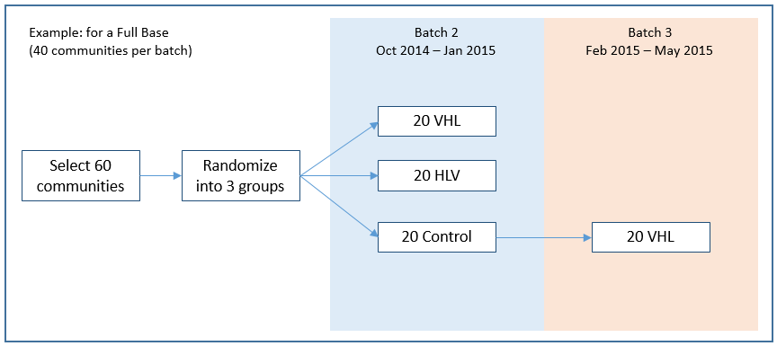
Formal vs Informal Values Training - RCT
Design
- VHL is the regular Transform Program (formal values training)
- HLV is a Transform variant (informal values training)
Notes:
For each study, will go through: 1) Design, 2) Implementation, 3) Results

Slide 6
Formal vs Informal Values Training - RCT
Results
Notes:
For each study, will go through: 1) Design, 2) Implementation, 3) Results

Slide 7
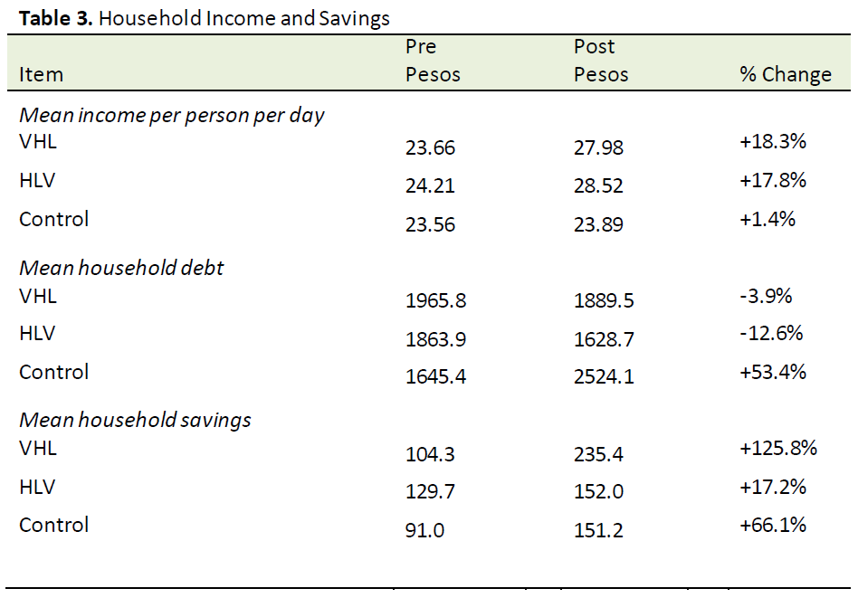
Formal vs Informal Values Training - RCT
Notes:
For each study, will go through: 1) Design, 2) Implementation, 3) Results

Slide 8
Formal vs Informal Values Training - RCT
Notes:
For each study, will go through: 1) Design, 2) Implementation, 3) Results

Slide 9
What is the Role of Religiosity in a Poverty Alleviation Program? - RCT
Design
In partnership with Innovations in Poverty Action (IPA) and Yale University
Programs: Feb 2015 to May 2015; Data collection: Jan 2015, Jun-Aug 2015 & Jun 2017
Locations involved: Negros Occidental, Negros Oriental, General Santos & Koronadal
Select 40 Pastors
(Each has 2 Communities, Total 80 Communities )
Group A
(20 Pastors, 40 Communities)
Group B
(20 Pastors, 40 Communities)
20 VHL
20 Control
20 HL
20 V only

Slide 10
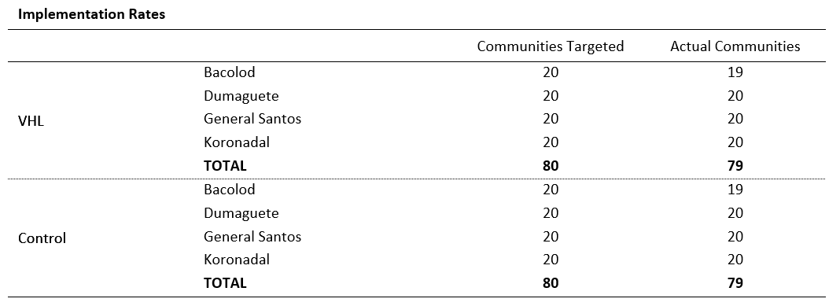
What is the Role of Religiosity in a Poverty Alleviation Program? - RCT
ICM and IPA collected data separately. ICM results:

Slide 11
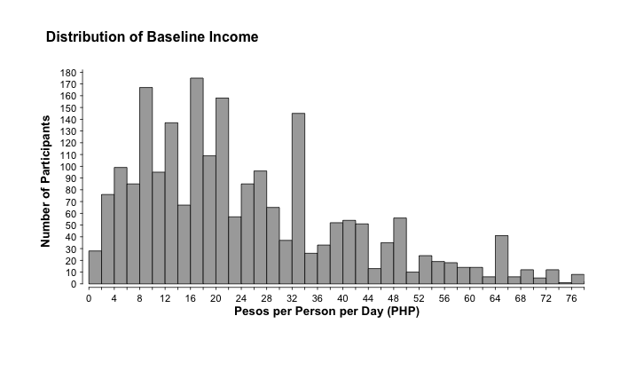
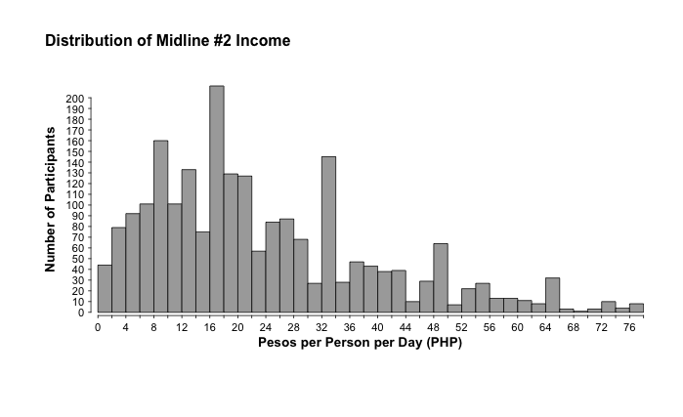
What is the Role of Religiosity in a Poverty Alleviation Program? - RCT

Slide 12
How do trainer characteristics affect program outcomes? - RCT
Design
In partnership with IPA & Yale University
ICM trainers were randomized to communities instead of regular assignments
Characteristics of interest
Education, duration of employment, age, sex, socioeconomic status, distance from office
ICM trainers were all surveyed in September 2016
Transform Program will run October 2016 – January 2017
Data Collection: Sep 2016 & Feb 2017

Slide 13
Trust and Malnutrition Intervention – Embedded Study
Does Social Capital affect Health Intervention Outcomes? Findings from a site-based child malnutrition intervention in the Philippines
Lincoln L Lau^{1,2}, Han Qu¹, Melinda Gill¹, Donald C Cole²
International Care Ministries, Philippines
Dalla Lana School of Public Health, University of Toronto

Slide 14
Trust and Malnutrition Intervention – Embedded Study
ICM implemented a child malnutrition intervention in 2012 and 2013
Site based program
Age <5 years
Weight for height z-score <2 SD below WHO growth standards
Food: rice based micronutrient fortified soy blended product
All cases registered at the local Rural Health Unit (RHU)
Deworming medication and Vitamin A supplementation provided at start of intervention

Slide 15
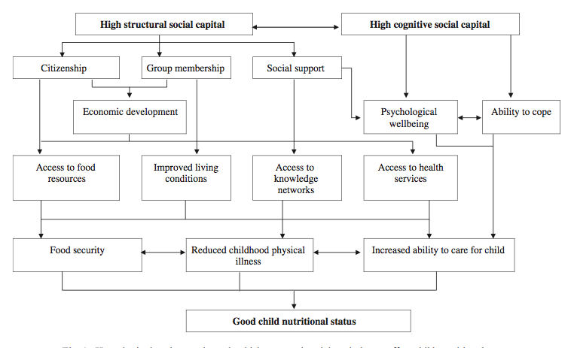
Trust and Malnutrition Intervention – Embedded Study
De Silva M, Harpham T. Health & Place 13 (2013) 341-355

Slide 16
Trust and Malnutrition Intervention – Embedded Study
Children admitted into the SBF program
n=2658
1403 female (52.8%)
Site-Based Feeding
16 weeks of feeding
Children gathered daily at a fixed location
Food prepared and feeding monitored by ICM staff
Anthropometrics at baseline and endline
Weight measured weekly
Deaths
n=6 (0.2%)
Dropout
n=436 (16.4%)
Completed program
n=2216 (83.4%)
Recovered
n=2093 (94.4%)
Unrecovered
n=123 (5.6%)

Slide 17
Trust and Malnutrition Intervention – Embedded Study
Model (proportional odds) | C1 TLB× geo | C2 TPC× geo
 | Coefficient (s.e.) | Coefficient (s.e.)
(Intercept) | 0.32 (0.87) | 0.78 (0.90)
Family Satisfaction | －0.40* (0.19) | －0.42* (0.19)
Trust Pastor Church | －1.07*** (0.29) | －1.47*** (0.34)
Trust Local Barangay Official | 0.99** (0.33) | 1.32*** (0.32)
geo – dense urban | －3.12* (1.59) | －3.72* (1.78)
geo – rural plain | －1.23 (1.37) | －2.25 (1.52)
geo – coastal | －4.57** (1.68) | －4.86** (1.55)
TLB× dense urban | 0.82* (0.41) | -
TLB× rural plain | 0.29 (0.33) | -
TLB× coastal | 1.24** (0.45) | -
TPC× dense urban | - | 0.92* (0.43)
TPC× rural plain | - | 0.52 (0.35)
TPC× coastal | - | 1.28** (0.41)

Slide 18
Trust and Malnutrition Intervention – Embedded Study
Linear model (WHZ change)
Age, intensity of poverty, and WHZ at admission correlated
None of the social capital items correlated
Logistic model (dropout)
Intensity of poverty
Trust in religious leader or pastor [-1.47, p<0.001]
Trust in local barangay [1.32, p<0.001]
Discussion
Limited capacity for ‘horizontal’ social networks?
Complementarity?

Slide 19
ICM Social Network Analysis Pilot
Social dimension of interventions
Social capital, social cohesion, social connectivity¹
Social networks & social norms²
Common measurement tools:
Integrated Questionnaire for the Measurement of Social Capital (SC-IQ) – World Bank (2003)
Measuring Social Capital in 5 Communities – P. Bullen & J. Onyx (1998)
Social Support Questionnaire 6 (SSQ6) – Sarason et al. (1987)
Count-based (numbers, means, percentages)
Putnam 1995 & Kawachi et al. 2008
World Bank Group. World Development Report - Mind, Society, and Behavior. 2015

Slide 20
ICM Social Network Analysis Pilot
Research Question:
Can we use Social Network Analytics to quantify the social dimension (baseline or change) for logframe and/or ToC purposes?

Slide 21
ICM Social Network Analysis Pilot
Transform’s Theory of Change (theorized)
Social capital as a possible mechanism in the pathway to outcomes
Ultra-poverty
Low income
Poor health
Lack of access to enterprise
Extreme-poverty
Increase in income
Improved health
Gain access to enterprise
Transform Program
Increased Social Capital?

Slide 22
ICM Social Network Analysis Pilot
Longitudinal data
Does this accurately describe what is happening?
 |  |  |  | PRE |  | POST
Item |  |  |  | n | (%) | n | (%) | Percent Change
Number Surveyed |  |  |  | 5984 | NA | 5001 | NA
How much do you trust your neighbors? |  | No Trust |  | 53 | 1% | 23 | 0% | -48%
 |  | Tentative Trust |  | 130 | 2% | 63 | 1% | -42%
 |  | Neutral |  | 1720 | 29% | 1159 | 23% | -19%
 |  | Moderate |  | 2682 | 45% | 2143 | 43% | -4%
 |  | Very Trusting |  | 1313 | 22% | 1519 | 30% | 38%
Score |  |  |  | 3.80 | NA | 3.96 | NA | 4%

Slide 23
ICM Social Network Analysis Pilot
Dynamic Social Network Analysis
Capture the social network at baseline (2 weeks prior) and at endline (2 weeks following completing of the program)
Measurement tool:
Developed in with Petr Matous, The University of Syndey
Similar to the ‘Name Generator’ [Matous et al. Field Methods. (2010)]
ALL members within a community need to be captured (surveyed)
Pilot of 10 communities

Slide 24
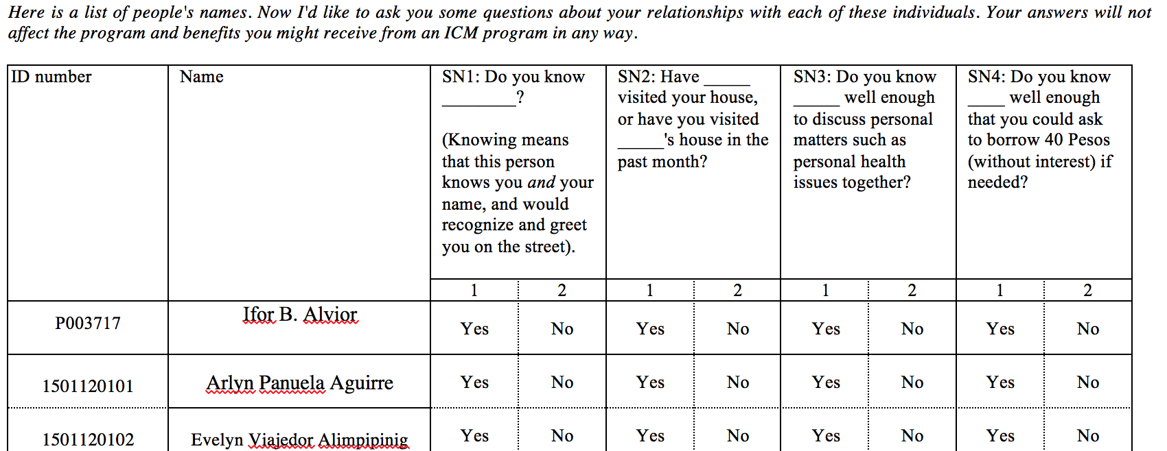
ICM Social Network Analysis Pilot
4 Questions:

Slide 25
ICM Social Network Analysis Pilot
SN1. Do you know _____________ ?

Slide 26
ICM Social Network Analysis Pilot
SN1. Do you know _____________ ?

Slide 27
ICM Social Network Analysis Pilot
SN2. Has ____ visited your house OR have you visited ____’s house in the last month ?

Slide 28
ICM Social Network Analysis Pilot
SN3. Do you know____ well enough to discuss personal health issues?

Slide 29
ICM Social Network Analysis Pilot
Statistics to describe the social dimension of network #3
 |  |  |  | PRE |  | POST
Item |  |  |  | n | (%) | n | (%) | % Change
Number Surveyed |  |  |  | 25 | NA | 25 | NA
How much do you trust your neighbors? |  | No Trust |  | 0 | 0 | 0 | 0 | NA
 |  | Tentative Trust |  | 2 | 0.08 | 0 | 0 | -100.00%
 |  | Neutral |  | 9 | 0.36 | 8 | 0.32 | -11.11%
 |  | Moderate |  | 12 | 0.48 | 17 | 0.68 | 41.67%
 |  | Very Trusting |  | 2 | 0.08 | 0 | 0 | -100.00%
 |  | Score |  | 3.56 | - | 3.68 | - | 3%

Slide 30
ICM Social Network Analysis Pilot
Statistics to describe the social dimension of network #3
Item |  |  | PRE | POST | % Change
SN1 - mean indegree/outdegree |  |  | 10.24 | 15.28 | 49.2%
SN1 - centralization indegree |  |  | 0.250 | 0.248 | -0.68%
SN2 - mean indegree/outdegree |  |  | 5.08 | 7.28 | 43.31%
SN2 - centralization indegree |  |  | 0.257 | 0.335 | 30.44%
SN3 - mean indegree/outdegree |  |  | 4.2 | 6.92 | 64.76%
SN3 - centralization indegree |  |  | 0.165 | 0.264 | 60.04%

Slide 31
ICM Social Network Analysis Pilot
Simple social network analytics
Offers a different picture of social connections and networks
Connectedness (indegree/outdegree or density)
Harmony/Uniformity (centralization or reciprocity)
Can analyze single communities
Also can provide insight on individual participants
Could be a metric to incorporate into logframes and ToCs
Also can have implications on RBM of interventions

Slide 32
End

Slide 33
Role of Research within ICM Operations
DESIGN EVALUATION FRAMEWORK/SURVEYS
DATA COLLECTION &
QUALITY
Values
Research
Collaborate to finalize questionnaire and methods
Metrics
Organize, hire and schedule: 1) Enumeration & 2) Encoding
Database
(Project Tomorrow, Dropbox, Google Drive, etc.)
Transform
Health
Prevail
Livelihood
ACCESS & DATA SYSTEMS
Thrive
Jumpstart
Monitoring
Reports
Research
Pre/Post
Survey
Managing programs
EOYR/EOB
Analysis
Strat 1/2/3
Other Studies
Program Design

Slide 34
Data Collection around Transform
Monitoring
(Statistics)
Evaluation
(Metrics)
Monthly Statistics
Target: All participants
Individual level data
Collected by: ICM trainers
Frequency: Weekly per Transform community
PRE/POST Survey
Target: All participants
Individual & household level data
Demographic, Education, Social Capital, Recent Illness, Sanitation Practices, Income, Poverty Indicators, etc.
Collected by: Contacted Enumerators
Frequency: Before and after each Transform
Medical Statistics
Target: Participants that receive a medical package
Individual level data
Collected by: ICM PHE trainer
Frequency: dependent on package
Transform
(assessing the program)
Learning
(Research)
Livelihood Statistics
Target: Participants that receive a Business in a box (BiB)
Collected by: ICM livelihood trainer
Frequency: Daily
Ongoing/Previous Projects
Malnutrition – correlates & predictors of successful treatment
Pregnancy Package – correlates of negative outcomes

